Slide 1
2023
YEAR-END
REPORT
National Affordability and Competitiveness Task Force
MARCH 2024
Notes:
This report highlights the success of the National Affordability and Competitiveness Task Force and its regional counterparts in 2023.
All cost savings are current as of March 2024.

Slide 2
SLIDE SHOW TIPS
Enhance your viewing experience with the following tips:
This PowerPoint includes animated text and videos. Allow time for the animation and videos to play.
Slides include facilitator notes. To see them while presenting, select
“Slide Show,” then “Presenter View” on your computer.
Share this slide deck with others! Simply copy and paste this link:
  lmpartnership.org/2023-nactf-annual-report
Notes:
Here are tips to improve your slide show experience:
This PowerPoint includes animated text and videos. Allow time for the animation and videos to play.
Slides include facilitator notes.
To see the notes while presenting, select “Slide Show,” then “Presenter View” on your computer.
Share this slide deck with others!
Simply copy and paste this link: https://www.lmpartnership.org/2023-nactf-annual-report

Slide 3
OUR STORY: An Introduction
The National Affordability and Competitiveness Task Force was formed as part of the 2021 Alliance National Agreement to bring together labor and management to explore issues of affordability, market position, and competition affecting the future of KP in each of its markets.
Notes:
The National Affordability and Competitiveness Task Force was formed as part of the 2021 Alliance National Agreement to bring together labor and management together to explore issues of affordability, market position and competition across the program.
The national task force is accountable for:
Identifying cost saving and efficiency opportunities that can help meet the affordability goal of the Alliance Performance Sharing Program
Providing guidance to Kaiser Permanente and Alliance leaders in the regions concerning regional affordability and competitiveness task forces
Promoting and sharing effective practices that achieve affordability, revenue, and growth across the organization
Jointly educating managers and Alliance-represented workers about issues of competitiveness, affordability, and sustainability
In addition to the national task force, there are 7 regional task forces in Colorado, Georgia, Hawaii, the Mid-Atlantic States, Northwest, Southern California, and Washington.

Slide 4
OUR STORY: 2023 NACTF Members & Executive Sponsors
ALLIANCE OF HEALTH CARE UNIONS
Jonathon Baker, vice president, OFNHP Local 5017
Micheal Barnett, president, USW Local 7600
Nate Bernstein, healthcare director, UFCW Local 7
Sandra Flores, chief of staff, Alliance of Health Care Unions
Charmaine Morales, president, UNAC/UHCP
KAISER PERMANENTE
Camille Applin-Jones, vice president, Ambulatory Care and Clinical Services, Northwest
CJ Bhalla, senior vice president and chief financial officer, Northern California
Sylvia Everroad, chief operating officer (retired), Southern California Permanente Medical Group
Leslie McKendrick, senior vice president and chief operating officer, Southern California and Hawaii
Jack Weberski, vice president (Economics), National Labor Relations
TRI-CHAIRS
Jim Pruitt, vice president of Labor Relations, The Permanente Federation
Hal Ruddick, executive director, Alliance of Health Care Unions
Steve Shields, senior vice president, National Labor Relations & Office of Labor Management Partnership
EXECUTIVE SPONSORS
Chris Grant, chief operating officer, Permanente Federation
Arlene Peasnall, senior vice president, Human Resources, Kaiser Permanente
Hal Ruddick, executive director, Alliance of Health Care Unions
Notes:
Alliance of Health Care Unions:
Jonathon Baker, Vice President, OFNHP Local 5017
Micheal Barnett, President, USW Local 7600
Nate Bernstein, Healthcare Director, UFCW Local 7
Sandra Flores, Chief of Staff, Alliance of Health Care Unions
Charmaine Morales, President, UNAC/UHCP
Kaiser Permanente:
Camille Applin-Jones, Vice President, Ambulatory Care and Clinical Services, Northwest
CJ Bhalla, Senior Vice President and Chief Financial Officer, Northern California
Sylvia Everroad, Chief Operating Officer (retired), Southern California Permanente Medical Group
Leslie McKendrick, Senior Vice President and Chief Operating Officer, Southern California and Hawaii
Jack Weberski, Vice President (Economics), National Labor Relations
Tri-Chairs:
Jim Pruitt, vice president of Labor Relations, The Permanente Federation
Hal Ruddick, executive director, Alliance of Health Care Unions
Steve Shields, senior vice president, National Labor Relations & Office of Labor Management Partnership
Executive Sponsors:
Chris Grant, Chief Operating Officer, Permanente Federation
Arlene Peasnall, Senior Vice President for Human Resources, Kaiser Permanente
Hal Ruddick, Executive Director, Alliance of Health Care Unions

Slide 5
OUR STORY: A Formula for Success
1 National Task Force
7 Regional Task Forces
56,600 Alliance-represented workers
$114.38 MILLION IN RECURRING
COST SAVINGS FOR 2023

Slide 6
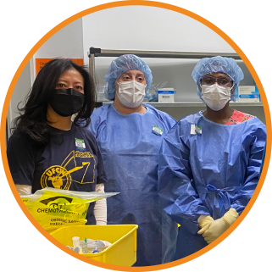
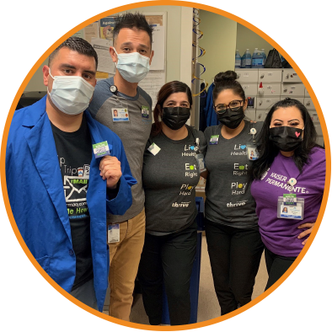
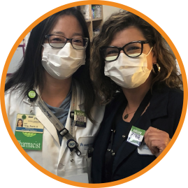
OUR STORY: A Timeline
2023
Regional task forces launch mutually approved affordability projects
National task force works with regional groups to assess progress of affordability initiatives, identify and surmount challenges, develop best practices
Regional task forces meet and exceed affordability targets
2021
Alliance National Agreement
establishes the National Affordability
and Competitiveness Task Force
2022
National task force convenes with 10 representatives from Kaiser Permanente
and Alliance of Health Care Unions
Task force members focus on governing structure and forming regional task forces
Regional task forces launch in Colorado, Georgia, Hawaii, Mid-Atlantic States, Northwest, Southern California and Washington
Notes:
The National Affordability and Competitiveness Task Force officially launched in February 2022 with 10 representatives from Kaiser Permanente and the Alliance of Health Care Unions.
Under the guidance of the national task force, management and labor established regional task forces to lead market-based affordability initiatives in Colorado, Georgia, the Mid-Atlantic States, Northwest, Southern California, Hawaii, and Washington.
Each regional task force was asked to identify cost-savings, revenue, and growth initiatives to achieve a recurring cost savings equal to 1.5% of the Alliance payroll in the region or service area.
Mutually approved projects launched in January 2023.

Slide 7
OUR MARKETS
Driving Innovation in Affordability, Attendance, Quality, Safety and Service

Slide 8
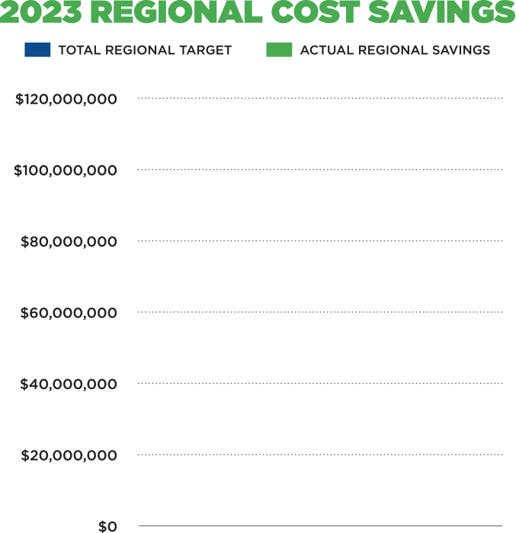
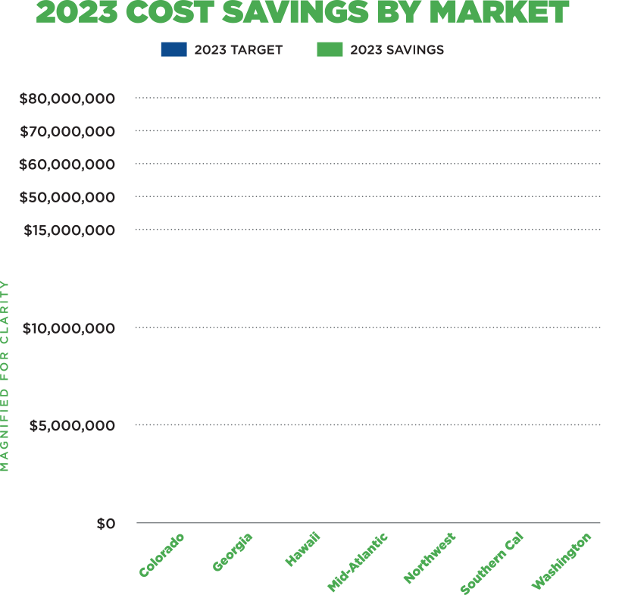
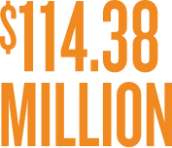

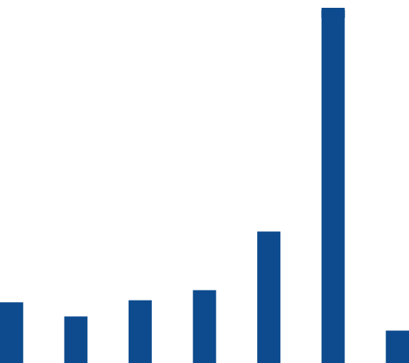

OUR MARKETS: By the Numbers
Notes:
Each regional task force surpassed its individual cost-savings target, thanks to labor and management working together to identify and address unique challenges in each market.
Collectively, we achieved more than $114 million in recurring cost savings in 2023 – 49% above target for the year!

Slide 9
OUR MARKETS: Avenues to Success
SEIZING OPPORTUNITY
Reducing external COVID-19 testing $27.7M savings
Converting from Humira® to Amjevita™
$16.4M savings
PRIORITIZING QUALITY OUTCOMES
Mid-Atlantic States: Embedding patient-care coordinators in urgent care
$3.1M savings
Northwest: Repatriating members from out-of-network emergency care
$1.1M savings
INNOVATING FROM THE FRONTLINE
Unit-based
team projects
More than
$41M savings
Notes:
Regions found success by seizing opportunities convert to Amjevita™, a biosimilar that is significantly less expensive than Humira®, with the same safety and efficacy for treating inflammatory disease; and to minimize external COVID-19 testing to reduce costs.
Regions also improved affordability by making gains in quality care. The Mid-Atlantic States is helping patients avoid unnecessary hospital stays and emergency room visits by using patient care coordinators to direct patients to effective care options. In the Northwest, frontline workers are helping to save more than $1 million by coordinating the return of KP patients receiving emergency care in non-KP facilities.
Unit-based teams are also helping Kaiser Permanente stay on top of its game. UBT projects in affordability, attendance, quality, safety, and service yielded more than $41 million in cost savings overall for 2023.

Slide 10
COLORADO
REGION:
Notes:
Colorado achieved $9.1 million in savings – more than 3 times its 2023 target.
Unit-based teams played a big role in the region’s success, contributing $8.6 million in savings from projects focused on quality, service, safety, and affordability.
Here are 2 examples:
The regional Behavioral Health Eating Disorder team achieved significant savings with help from Amie Schuman, a licensed clinical social worker and UFCW Local 7 member. As part of a quality project to improve care, Schuman received specialized training and developed a comprehensive screening tool to assess the needs of patients with a rare eating disorder. The resulting decrease in outside referrals and treatment led to $405,000 in savings – and more effective care for our members and patients.
Optometry teams saved more than $100,000 by reducing waste in diagnostic eyedrops – helping to deliver the best eye care without the wasteful practices of the past.
Watch the short video to learn more.
Looking ahead this year, the region plans to: Increase opportunities for UBT affordability projects, reduce medically unnecessary emergency department use, and build consensus on Finance engagement and decision-making authority for regional task force

Slide 11



COLORADO
Notes:
Colorado achieved $9.1 million in savings – more than 3 times its 2023 target.
Unit-based teams played a big role in the region’s success, contributing $8.6 million in savings from projects focused on quality, service, safety, and affordability.
Here are 2 examples:
The regional Behavioral Health Eating Disorder team achieved significant savings with help from Amie Schuman, a licensed clinical social worker and UFCW Local 7 member. As part of a quality project to improve care, Schuman received specialized training and developed a comprehensive screening tool to assess the needs of patients with a rare eating disorder. The resulting decrease in outside referrals and treatment led to $405,000 in savings – and more effective care for our members and patients.
Optometry teams saved more than $100,000 by reducing waste in diagnostic eyedrops – helping to deliver the best eye care without the wasteful practices of the past.
Watch the short video to learn more.
Looking ahead this year, the region plans to: Increase opportunities for UBT affordability projects, reduce medically unnecessary emergency department use, and build consensus on Finance engagement and decision-making authority for regional task force

Slide 12

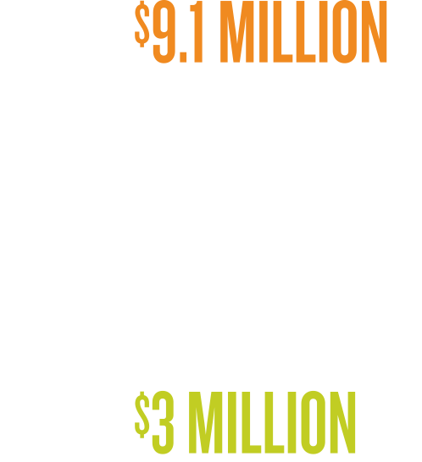

COLORADO
Notes:
Colorado achieved $9.1 million in savings – more than 3 times its 2023 target.
Unit-based teams played a big role in the region’s success, contributing $8.6 million in savings from projects focused on quality, service, safety, and affordability.
Here are 2 examples:
The regional Behavioral Health Eating Disorder team achieved significant savings with help from Amie Schuman, a licensed clinical social worker and UFCW Local 7 member. As part of a quality project to improve care, Schuman received specialized training and developed a comprehensive screening tool to assess the needs of patients with a rare eating disorder. The resulting decrease in outside referrals and treatment led to $405,000 in savings – and more effective care for our members and patients.
Optometry teams saved more than $100,000 by reducing waste in diagnostic eyedrops – helping to deliver the best eye care without the wasteful practices of the past.
Watch the short video to learn more.
Looking ahead this year, the region plans to: Increase opportunities for UBT affordability projects, reduce medically unnecessary emergency department use, and build consensus on Finance engagement and decision-making authority for regional task force

Slide 13



COLORADO
Notes:
Colorado achieved $9.1 million in savings – more than 3 times its 2023 target.
Unit-based teams played a big role in the region’s success, contributing $8.6 million in savings from projects focused on quality, service, safety, and affordability.
Here are 2 examples:
The regional Behavioral Health Eating Disorder team achieved significant savings with help from Amie Schuman, a licensed clinical social worker and UFCW Local 7 member. As part of a quality project to improve care, Schuman received specialized training and developed a comprehensive screening tool to assess the needs of patients with a rare eating disorder. The resulting decrease in outside referrals and treatment led to $405,000 in savings – and more effective care for our members and patients.
Optometry teams saved more than $100,000 by reducing waste in diagnostic eyedrops – helping to deliver the best eye care without the wasteful practices of the past.
Watch the short video to learn more.
Looking ahead this year, the region plans to: Increase opportunities for UBT affordability projects, reduce medically unnecessary emergency department use, and build consensus on Finance engagement and decision-making authority for regional task force

Slide 14

COLORADO
Notes:
Colorado achieved $9.1 million in savings – more than 3 times its 2023 target.
Unit-based teams played a big role in the region’s success, contributing $8.6 million in savings from projects focused on quality, service, safety, and affordability.
Here are 2 examples:
The regional Behavioral Health Eating Disorder team achieved significant savings with help from Amie Schuman, a licensed clinical social worker and UFCW Local 7 member. As part of a quality project to improve care, Schuman received specialized training and developed a comprehensive screening tool to assess the needs of patients with a rare eating disorder. The resulting decrease in outside referrals and treatment led to $405,000 in savings – and more effective care for our members and patients.
Optometry teams saved more than $100,000 by reducing waste in diagnostic eyedrops – helping to deliver the best eye care without the wasteful practices of the past.
Watch the short video to learn more.
Looking ahead this year, the region plans to: Increase opportunities for UBT affordability projects, reduce medically unnecessary emergency department use, and build consensus on Finance engagement and decision-making authority for regional task force

Slide 15

COLORADO
Notes:
Colorado achieved $9.1 million in savings – more than 3 times its 2023 target.
Unit-based teams played a big role in the region’s success, contributing $8.6 million in savings from projects focused on quality, service, safety, and affordability.
Here are 2 examples:
The regional Behavioral Health Eating Disorder team achieved significant savings with help from Amie Schuman, a licensed clinical social worker and UFCW Local 7 member. As part of a quality project to improve care, Schuman received specialized training and developed a comprehensive screening tool to assess the needs of patients with a rare eating disorder. The resulting decrease in outside referrals and treatment led to $405,000 in savings – and more effective care for our members and patients.
Optometry teams saved more than $100,000 by reducing waste in diagnostic eyedrops – helping to deliver the best eye care without the wasteful practices of the past.
Watch the short video to learn more.
Looking ahead this year, the region plans to: Increase opportunities for UBT affordability projects, reduce medically unnecessary emergency department use, and build consensus on Finance engagement and decision-making authority for regional task force

Slide 16

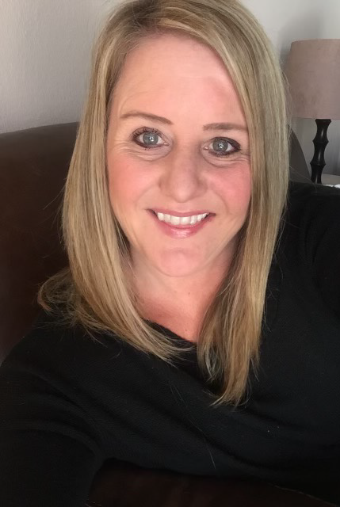
COLORADO
Treating Patients with Eating Disorders:
Amie Schuman (right), licensed clinical
social worker and UFCW Local 7 member,
developed a screening tool to assess
and treat patients with rare eating
disorder. Resulting decrease in
outside referrals led to $405K
in savings.
Amie Shuman
UFCW Local 7
Notes:
Colorado achieved $9.1 million in savings – more than 3 times its 2023 target.
Unit-based teams played a big role in the region’s success, contributing $8.6 million in savings from projects focused on quality, service, safety, and affordability.
Here are 2 examples:
The regional Behavioral Health Eating Disorder team achieved significant savings with help from Amie Schuman, a licensed clinical social worker and UFCW Local 7 member. As part of a quality project to improve care, Schuman received specialized training and developed a comprehensive screening tool to assess the needs of patients with a rare eating disorder. The resulting decrease in outside referrals and treatment led to $405,000 in savings – and more effective care for our members and patients.
Optometry teams saved more than $100,000 by reducing waste in diagnostic eyedrops – helping to deliver the best eye care without the wasteful practices of the past.
Watch the short video to learn more.
Looking ahead this year, the region plans to: Increase opportunities for UBT affordability projects, reduce medically unnecessary emergency department use, and build consensus on Finance engagement and decision-making authority for regional task force

Slide 17

COLORADO
VIDEO
Reducing Waste in Diagnostic Eyedrops (video): Optometry
teams contributed to making care
more affordable by reducing waste
in eyedrops, saving $102K.
Notes:
Colorado achieved $9.1 million in savings – more than 3 times its 2023 target.
Unit-based teams played a big role in the region’s success, contributing $8.6 million in savings from projects focused on quality, service, safety, and affordability.
Here are 2 examples:
The regional Behavioral Health Eating Disorder team achieved significant savings with help from Amie Schuman, a licensed clinical social worker and UFCW Local 7 member. As part of a quality project to improve care, Schuman received specialized training and developed a comprehensive screening tool to assess the needs of patients with a rare eating disorder. The resulting decrease in outside referrals and treatment led to $405,000 in savings – and more effective care for our members and patients.
Optometry teams saved more than $100,000 by reducing waste in diagnostic eyedrops – helping to deliver the best eye care without the wasteful practices of the past.
Watch the short video to learn more.
Looking ahead this year, the region plans to: Increase opportunities for UBT affordability projects, reduce medically unnecessary emergency department use, and build consensus on Finance engagement and decision-making authority for regional task force

Slide 18


COLORADO
Increase opportunities for UBT affordability projects
Reduce medically unnecessary emergency department use
Build consensus on Finance engagement and decision-making authority for regional task force
Notes:
Colorado achieved $9.1 million in savings – more than 3 times its 2023 target.
Unit-based teams played a big role in the region’s success, contributing $8.6 million in savings from projects focused on quality, service, safety, and affordability.
Here are 2 examples:
The regional Behavioral Health Eating Disorder team achieved significant savings with help from Amie Schuman, a licensed clinical social worker and UFCW Local 7 member. As part of a quality project to improve care, Schuman received specialized training and developed a comprehensive screening tool to assess the needs of patients with a rare eating disorder. The resulting decrease in outside referrals and treatment led to $405,000 in savings – and more effective care for our members and patients.
Optometry teams saved more than $100,000 by reducing waste in diagnostic eyedrops – helping to deliver the best eye care without the wasteful practices of the past.
Watch the short video to learn more.
Looking ahead this year, the region plans to: Increase opportunities for UBT affordability projects, reduce medically unnecessary emergency department use, and build consensus on Finance engagement and decision-making authority for regional task force

Slide 19
GEORGIA
REGION:
Notes:
Georgia achieved $2.67 million cost savings in 2023 – 16% above target.
Capturing lost revenue in the region’s main medical offices played a big role in Georgia’s success. Staff members used scripting to ask patients about outstanding balances and co-pays. They also encouraged patients to use automated kiosks, which require payment before the check-in process can be completed.
Improved over-the-counter sales in pharmacies also contributed to Georgia’s cost savings. As part of a national pharmacy effort to improve care and service, 6 pharmacies changed the way they stock over-the-counter products. They also added automated checkout systems to reduce customer wait times. Watch the short video to learn more.
Looking ahead this year, the region plans to: update procedures for hysterectomies and incontinence in ways that are less expensive and better for the patient; and continue to seek savings from increased outstanding balance collections and more over-the-counter pharmacy sales.

Slide 20

GEORGIA
Notes:
Georgia achieved $2.67 million cost savings in 2023 – 16% above target.
Capturing lost revenue in the region’s main medical offices played a big role in Georgia’s success. Staff members used scripting to ask patients about outstanding balances and co-pays. They also encouraged patients to use automated kiosks, which require payment before the check-in process can be completed.
Improved over-the-counter sales in pharmacies also contributed to Georgia’s cost savings. As part of a national pharmacy effort to improve care and service, 6 pharmacies changed the way they stock over-the-counter products. They also added automated checkout systems to reduce customer wait times. Watch the short video to learn more.
Looking ahead this year, the region plans to: update procedures for hysterectomies and incontinence in ways that are less expensive and better for the patient; and continue to seek savings from increased outstanding balance collections and more over-the-counter pharmacy sales.

Slide 21
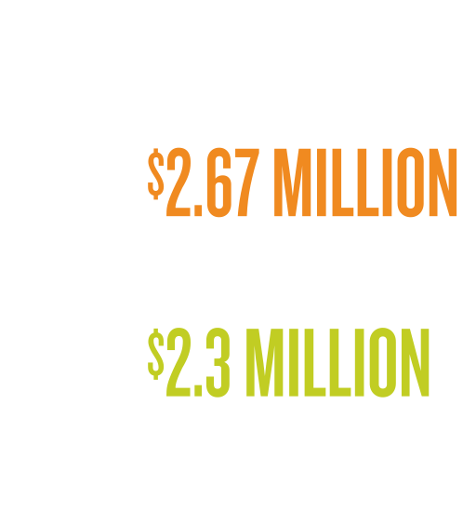
GEORGIA
Notes:
Georgia achieved $2.67 million cost savings in 2023 – 16% above target.
Capturing lost revenue in the region’s main medical offices played a big role in Georgia’s success. Staff members used scripting to ask patients about outstanding balances and co-pays. They also encouraged patients to use automated kiosks, which require payment before the check-in process can be completed.
Improved over-the-counter sales in pharmacies also contributed to Georgia’s cost savings. As part of a national pharmacy effort to improve care and service, 6 pharmacies changed the way they stock over-the-counter products. They also added automated checkout systems to reduce customer wait times. Watch the short video to learn more.
Looking ahead this year, the region plans to: update procedures for hysterectomies and incontinence in ways that are less expensive and better for the patient; and continue to seek savings from increased outstanding balance collections and more over-the-counter pharmacy sales.

Slide 22

GEORGIA
Notes:
Georgia achieved $2.67 million cost savings in 2023 – 16% above target.
Capturing lost revenue in the region’s main medical offices played a big role in Georgia’s success. Staff members used scripting to ask patients about outstanding balances and co-pays. They also encouraged patients to use automated kiosks, which require payment before the check-in process can be completed.
Improved over-the-counter sales in pharmacies also contributed to Georgia’s cost savings. As part of a national pharmacy effort to improve care and service, 6 pharmacies changed the way they stock over-the-counter products. They also added automated checkout systems to reduce customer wait times. Watch the short video to learn more.
Looking ahead this year, the region plans to: update procedures for hysterectomies and incontinence in ways that are less expensive and better for the patient; and continue to seek savings from increased outstanding balance collections and more over-the-counter pharmacy sales.

Slide 23

GEORGIA
Notes:
Georgia achieved $2.67 million cost savings in 2023 – 16% above target.
Capturing lost revenue in the region’s main medical offices played a big role in Georgia’s success. Staff members used scripting to ask patients about outstanding balances and co-pays. They also encouraged patients to use automated kiosks, which require payment before the check-in process can be completed.
Improved over-the-counter sales in pharmacies also contributed to Georgia’s cost savings. As part of a national pharmacy effort to improve care and service, 6 pharmacies changed the way they stock over-the-counter products. They also added automated checkout systems to reduce customer wait times. Watch the short video to learn more.
Looking ahead this year, the region plans to: update procedures for hysterectomies and incontinence in ways that are less expensive and better for the patient; and continue to seek savings from increased outstanding balance collections and more over-the-counter pharmacy sales.

Slide 24
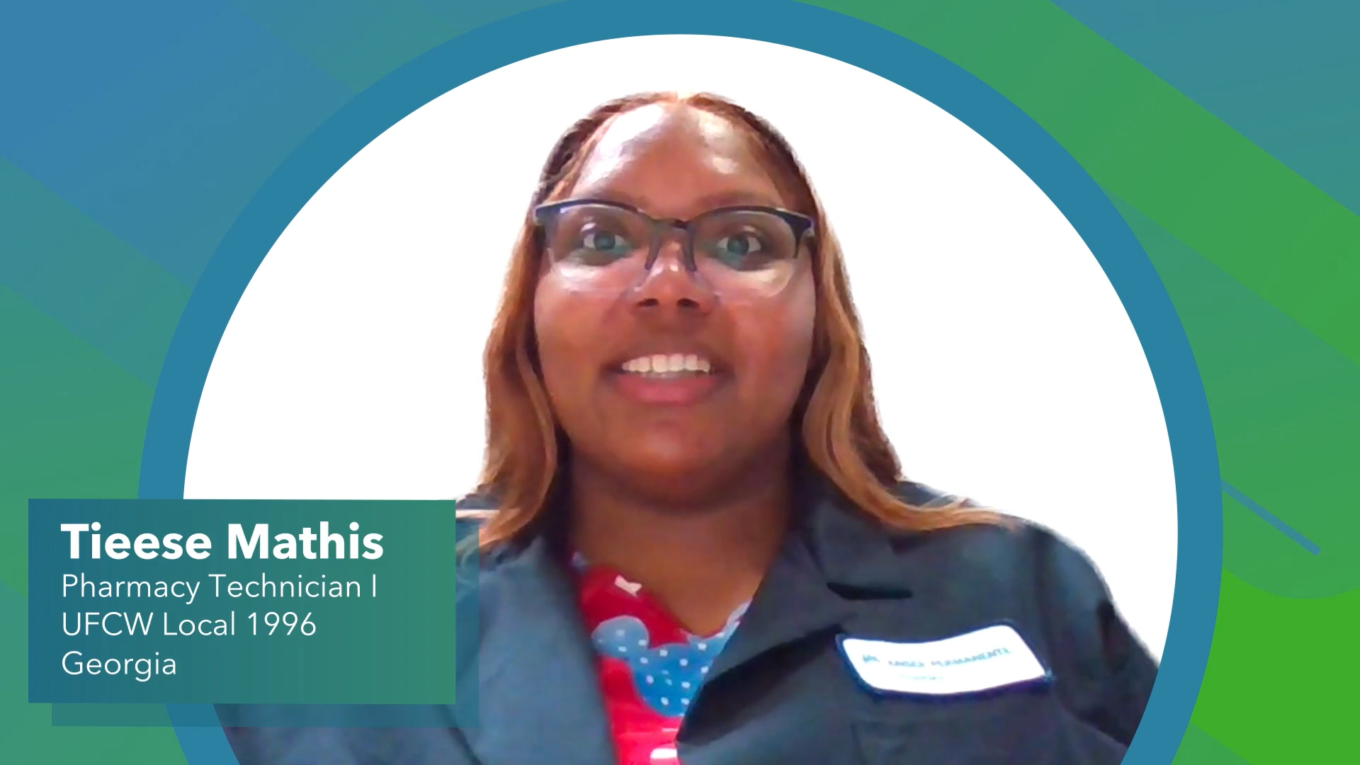
GEORGIA
VIDEO
Increasing over-the-counter
pharmacy sales (video): This
pharmacy team contributed to
making care more affordable by
listening to patients and then
ensuring it had the right supplies
at the right time. The result?
$100K in over-the-counter
pharmacy sales.
Notes:
Georgia achieved $2.67 million cost savings in 2023 – 16% above target.
Capturing lost revenue in the region’s main medical offices played a big role in Georgia’s success. Staff members used scripting to ask patients about outstanding balances and co-pays. They also encouraged patients to use automated kiosks, which require payment before the check-in process can be completed.
Improved over-the-counter sales in pharmacies also contributed to Georgia’s cost savings. As part of a national pharmacy effort to improve care and service, 6 pharmacies changed the way they stock over-the-counter products. They also added automated checkout systems to reduce customer wait times. Watch the short video to learn more.
Looking ahead this year, the region plans to: update procedures for hysterectomies and incontinence in ways that are less expensive and better for the patient; and continue to seek savings from increased outstanding balance collections and more over-the-counter pharmacy sales.

Slide 25
GEORGIA
Update procedures for hysterectomies
and incontinence that are less expensive,
better for patients
Continue savings from increased
outstanding balance collections and
over-the-counter pharmacy sales
Notes:
Georgia achieved $2.67 million cost savings in 2023 – 16% above target.
Capturing lost revenue in the region’s main medical offices played a big role in Georgia’s success. Staff members used scripting to ask patients about outstanding balances and co-pays. They also encouraged patients to use automated kiosks, which require payment before the check-in process can be completed.
Improved over-the-counter sales in pharmacies also contributed to Georgia’s cost savings. As part of a national pharmacy effort to improve care and service, 6 pharmacies changed the way they stock over-the-counter products. They also added automated checkout systems to reduce customer wait times. Watch the short video to learn more.
Looking ahead this year, the region plans to: update procedures for hysterectomies and incontinence in ways that are less expensive and better for the patient; and continue to seek savings from increased outstanding balance collections and more over-the-counter pharmacy sales.

Slide 26
HAWAI’I
REGION:
Notes:
Hawaii achieved $3.88 million in cost savings – 25% above target.
Successes include increasing attendance, improving quality care by reducing healthcare-associated infections, and converting from Humira® to Amjevita™.
Examples of noteworthy UBT projects include:
The ICU and Cardiovascular ICU team at Moanalua Medical Center, which reduced catheter-induced urinary tract infections by more than 73%. Their success helped reduce healthcare-associated infections throughout the Hawaii market and save nearly $1 million.
The Hilo/Waimea primary care team also significantly reduced costs by promoting mail-order pharmacy options – saving about $100,000.
Looking ahead this year, the region plans to: Continue engaging all unit-based teams and involved the outer islands in ongoing affordability work.

Slide 27

HAWAI’I
Notes:
Hawaii achieved $3.88 million in cost savings – 25% above target.
Successes include increasing attendance, improving quality care by reducing healthcare-associated infections, and converting from Humira® to Amjevita™.
Examples of noteworthy UBT projects include:
The ICU and Cardiovascular ICU team at Moanalua Medical Center, which reduced catheter-induced urinary tract infections by more than 73%. Their success helped reduce healthcare-associated infections throughout the Hawaii market and save nearly $1 million.
The Hilo/Waimea primary care team also significantly reduced costs by promoting mail-order pharmacy options – saving about $100,000.
Looking ahead this year, the region plans to: Continue engaging all unit-based teams and involved the outer islands in ongoing affordability work.

Slide 28
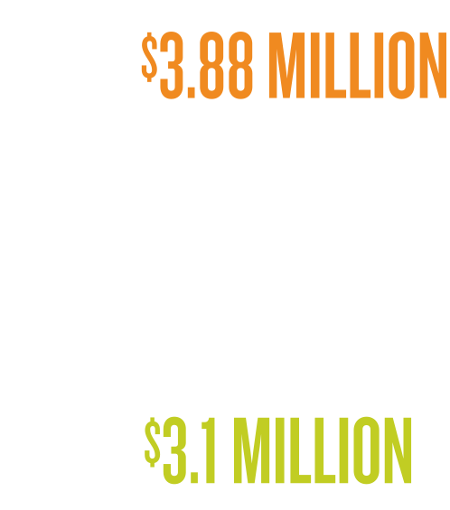
HAWAI’I
Notes:
Hawaii achieved $3.88 million in cost savings – 25% above target.
Successes include increasing attendance, improving quality care by reducing healthcare-associated infections, and converting from Humira® to Amjevita™.
Examples of noteworthy UBT projects include:
The ICU and Cardiovascular ICU team at Moanalua Medical Center, which reduced catheter-induced urinary tract infections by more than 73%. Their success helped reduce healthcare-associated infections throughout the Hawaii market and save nearly $1 million.
The Hilo/Waimea primary care team also significantly reduced costs by promoting mail-order pharmacy options – saving about $100,000.
Looking ahead this year, the region plans to: Continue engaging all unit-based teams and involved the outer islands in ongoing affordability work.

Slide 29

HAWAI’I
Notes:
Hawaii achieved $3.88 million in cost savings – 25% above target.
Successes include increasing attendance, improving quality care by reducing healthcare-associated infections, and converting from Humira® to Amjevita™.
Examples of noteworthy UBT projects include:
The ICU and Cardiovascular ICU team at Moanalua Medical Center, which reduced catheter-induced urinary tract infections by more than 73%. Their success helped reduce healthcare-associated infections throughout the Hawaii market and save nearly $1 million.
The Hilo/Waimea primary care team also significantly reduced costs by promoting mail-order pharmacy options – saving about $100,000.
Looking ahead this year, the region plans to: Continue engaging all unit-based teams and involved the outer islands in ongoing affordability work.

Slide 30

HAWAI’I
Notes:
Hawaii achieved $3.88 million in cost savings – 25% above target.
Successes include increasing attendance, improving quality care by reducing healthcare-associated infections, and converting from Humira® to Amjevita™.
Examples of noteworthy UBT projects include:
The ICU and Cardiovascular ICU team at Moanalua Medical Center, which reduced catheter-induced urinary tract infections by more than 73%. Their success helped reduce healthcare-associated infections throughout the Hawaii market and save nearly $1 million.
The Hilo/Waimea primary care team also significantly reduced costs by promoting mail-order pharmacy options – saving about $100,000.
Looking ahead this year, the region plans to: Continue engaging all unit-based teams and involved the outer islands in ongoing affordability work.

Slide 31

HAWAI’I
Notes:
Hawaii achieved $3.88 million in cost savings – 25% above target.
Successes include increasing attendance, improving quality care by reducing healthcare-associated infections, and converting from Humira® to Amjevita™.
Examples of noteworthy UBT projects include:
The ICU and Cardiovascular ICU team at Moanalua Medical Center, which reduced catheter-induced urinary tract infections by more than 73%. Their success helped reduce healthcare-associated infections throughout the Hawaii market and save nearly $1 million.
The Hilo/Waimea primary care team also significantly reduced costs by promoting mail-order pharmacy options – saving about $100,000.
Looking ahead this year, the region plans to: Continue engaging all unit-based teams and involved the outer islands in ongoing affordability work.

Slide 32

HAWAI’I
Notes:
Hawaii achieved $3.88 million in cost savings – 25% above target.
Successes include increasing attendance, improving quality care by reducing healthcare-associated infections, and converting from Humira® to Amjevita™.
Examples of noteworthy UBT projects include:
The ICU and Cardiovascular ICU team at Moanalua Medical Center, which reduced catheter-induced urinary tract infections by more than 73%. Their success helped reduce healthcare-associated infections throughout the Hawaii market and save nearly $1 million.
The Hilo/Waimea primary care team also significantly reduced costs by promoting mail-order pharmacy options – saving about $100,000.
Looking ahead this year, the region plans to: Continue engaging all unit-based teams and involved the outer islands in ongoing affordability work.

Slide 33

HAWAI’I
Reducing Healthcare-Associated
Infections: Market-wide effort to
reduce infections resulted in nearly
$1M in savings. The Moanalua
intensive care team (pictured)
contributed to this effort, saving
more than $245K by reducing
catheter-associated urinary
tract infections.
Notes:
Hawaii achieved $3.88 million in cost savings – 25% above target.
Successes include increasing attendance, improving quality care by reducing healthcare-associated infections, and converting from Humira® to Amjevita™.
Examples of noteworthy UBT projects include:
The ICU and Cardiovascular ICU team at Moanalua Medical Center, which reduced catheter-induced urinary tract infections by more than 73%. Their success helped reduce healthcare-associated infections throughout the Hawaii market and save nearly $1 million.
The Hilo/Waimea primary care team also significantly reduced costs by promoting mail-order pharmacy options – saving about $100,000.
Looking ahead this year, the region plans to: Continue engaging all unit-based teams and involved the outer islands in ongoing affordability work.

Slide 34

HAWAI’I
Promoting Mail-Order Pharmacy:
The Hilo/Waimea primary care team
saved nearly $100K by promoting
use of mail-order pharmacy.
Notes:
Hawaii achieved $3.88 million in cost savings – 25% above target.
Successes include increasing attendance, improving quality care by reducing healthcare-associated infections, and converting from Humira® to Amjevita™.
Examples of noteworthy UBT projects include:
The ICU and Cardiovascular ICU team at Moanalua Medical Center, which reduced catheter-induced urinary tract infections by more than 73%. Their success helped reduce healthcare-associated infections throughout the Hawaii market and save nearly $1 million.
The Hilo/Waimea primary care team also significantly reduced costs by promoting mail-order pharmacy options – saving about $100,000.
Looking ahead this year, the region plans to: Continue engaging all unit-based teams and involved the outer islands in ongoing affordability work.

Slide 35
HAWAI’I
Engage all UBTs
Involve outer islands
in affordability work
Notes:
Hawaii achieved $3.88 million in cost savings – 25% above target.
Successes include increasing attendance, improving quality care by reducing healthcare-associated infections, and converting from Humira® to Amjevita™.
Examples of noteworthy UBT projects include:
The ICU and Cardiovascular ICU team at Moanalua Medical Center, which reduced catheter-induced urinary tract infections by more than 73%. Their success helped reduce healthcare-associated infections throughout the Hawaii market and save nearly $1 million.
The Hilo/Waimea primary care team also significantly reduced costs by promoting mail-order pharmacy options – saving about $100,000.
Looking ahead this year, the region plans to: Continue engaging all unit-based teams and involved the outer islands in ongoing affordability work.

Slide 36
MID-ATLANTIC
STATES
REGION:
Notes:
Mid-Atlantic achieved $5.38 million in savings – 49% above target.
The biggest cost savings comes from the region’s Continuum of Care initiative, which embeds patient care coordinators in urgent care and advanced urgent care units to help reduce unnecessary hospitalizations and emergency room visits.
Begun in June 2023 as a pilot, the program has reduced the ‘Average Daily Transfer Rate’ from urgent care units to hospitals.
The project’s success is attracting attention. Urgent care units in other markets are looking to adopt a similar approach to reduce hospitalizations and emergency room referrals.
Looking ahead, the region plans to: Enhance collaboration with operational leaders to assist with affordability projects and align task force work with regional priorities.

Slide 37

MID-ATLANTIC STATES
Notes:
Mid-Atlantic achieved $5.38 million in savings – 49% above target.
The biggest cost savings comes from the region’s Continuum of Care initiative, which embeds patient care coordinators in urgent care and advanced urgent care units to help reduce unnecessary hospitalizations and emergency room visits.
Begun in June 2023 as a pilot, the program has reduced the ‘Average Daily Transfer Rate’ from urgent care units to hospitals.
The project’s success is attracting attention. Urgent care units in other markets are looking to adopt a similar approach to reduce hospitalizations and emergency room referrals.
Looking ahead, the region plans to: Enhance collaboration with operational leaders to assist with affordability projects and align task force work with regional priorities.

Slide 38
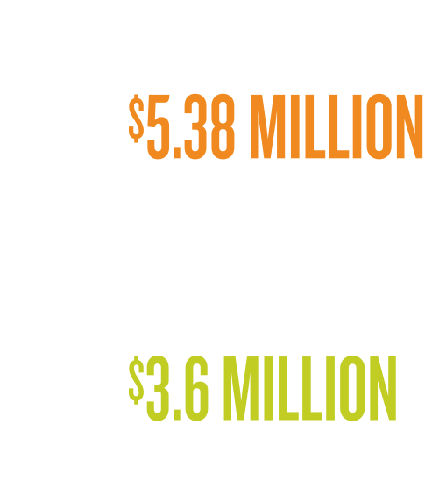
MID-ATLANTIC STATES
Notes:
Mid-Atlantic achieved $5.38 million in savings – 49% above target.
The biggest cost savings comes from the region’s Continuum of Care initiative, which embeds patient care coordinators in urgent care and advanced urgent care units to help reduce unnecessary hospitalizations and emergency room visits.
Begun in June 2023 as a pilot, the program has reduced the ‘Average Daily Transfer Rate’ from urgent care units to hospitals.
The project’s success is attracting attention. Urgent care units in other markets are looking to adopt a similar approach to reduce hospitalizations and emergency room referrals.
Looking ahead, the region plans to: Enhance collaboration with operational leaders to assist with affordability projects and align task force work with regional priorities.

Slide 39

MID-ATLANTIC STATES
Notes:
Mid-Atlantic achieved $5.38 million in savings – 49% above target.
The biggest cost savings comes from the region’s Continuum of Care initiative, which embeds patient care coordinators in urgent care and advanced urgent care units to help reduce unnecessary hospitalizations and emergency room visits.
Begun in June 2023 as a pilot, the program has reduced the ‘Average Daily Transfer Rate’ from urgent care units to hospitals.
The project’s success is attracting attention. Urgent care units in other markets are looking to adopt a similar approach to reduce hospitalizations and emergency room referrals.
Looking ahead, the region plans to: Enhance collaboration with operational leaders to assist with affordability projects and align task force work with regional priorities.

Slide 40

MID-ATLANTIC STATES
Notes:
Mid-Atlantic achieved $5.38 million in savings – 49% above target.
The biggest cost savings comes from the region’s Continuum of Care initiative, which embeds patient care coordinators in urgent care and advanced urgent care units to help reduce unnecessary hospitalizations and emergency room visits.
Begun in June 2023 as a pilot, the program has reduced the ‘Average Daily Transfer Rate’ from urgent care units to hospitals.
The project’s success is attracting attention. Urgent care units in other markets are looking to adopt a similar approach to reduce hospitalizations and emergency room referrals.
Looking ahead, the region plans to: Enhance collaboration with operational leaders to assist with affordability projects and align task force work with regional priorities.

Slide 41

MID-ATLANTIC STATES
Notes:
Mid-Atlantic achieved $5.38 million in savings – 49% above target.
The biggest cost savings comes from the region’s Continuum of Care initiative, which embeds patient care coordinators in urgent care and advanced urgent care units to help reduce unnecessary hospitalizations and emergency room visits.
Begun in June 2023 as a pilot, the program has reduced the ‘Average Daily Transfer Rate’ from urgent care units to hospitals.
The project’s success is attracting attention. Urgent care units in other markets are looking to adopt a similar approach to reduce hospitalizations and emergency room referrals.
Looking ahead, the region plans to: Enhance collaboration with operational leaders to assist with affordability projects and align task force work with regional priorities.

Slide 42
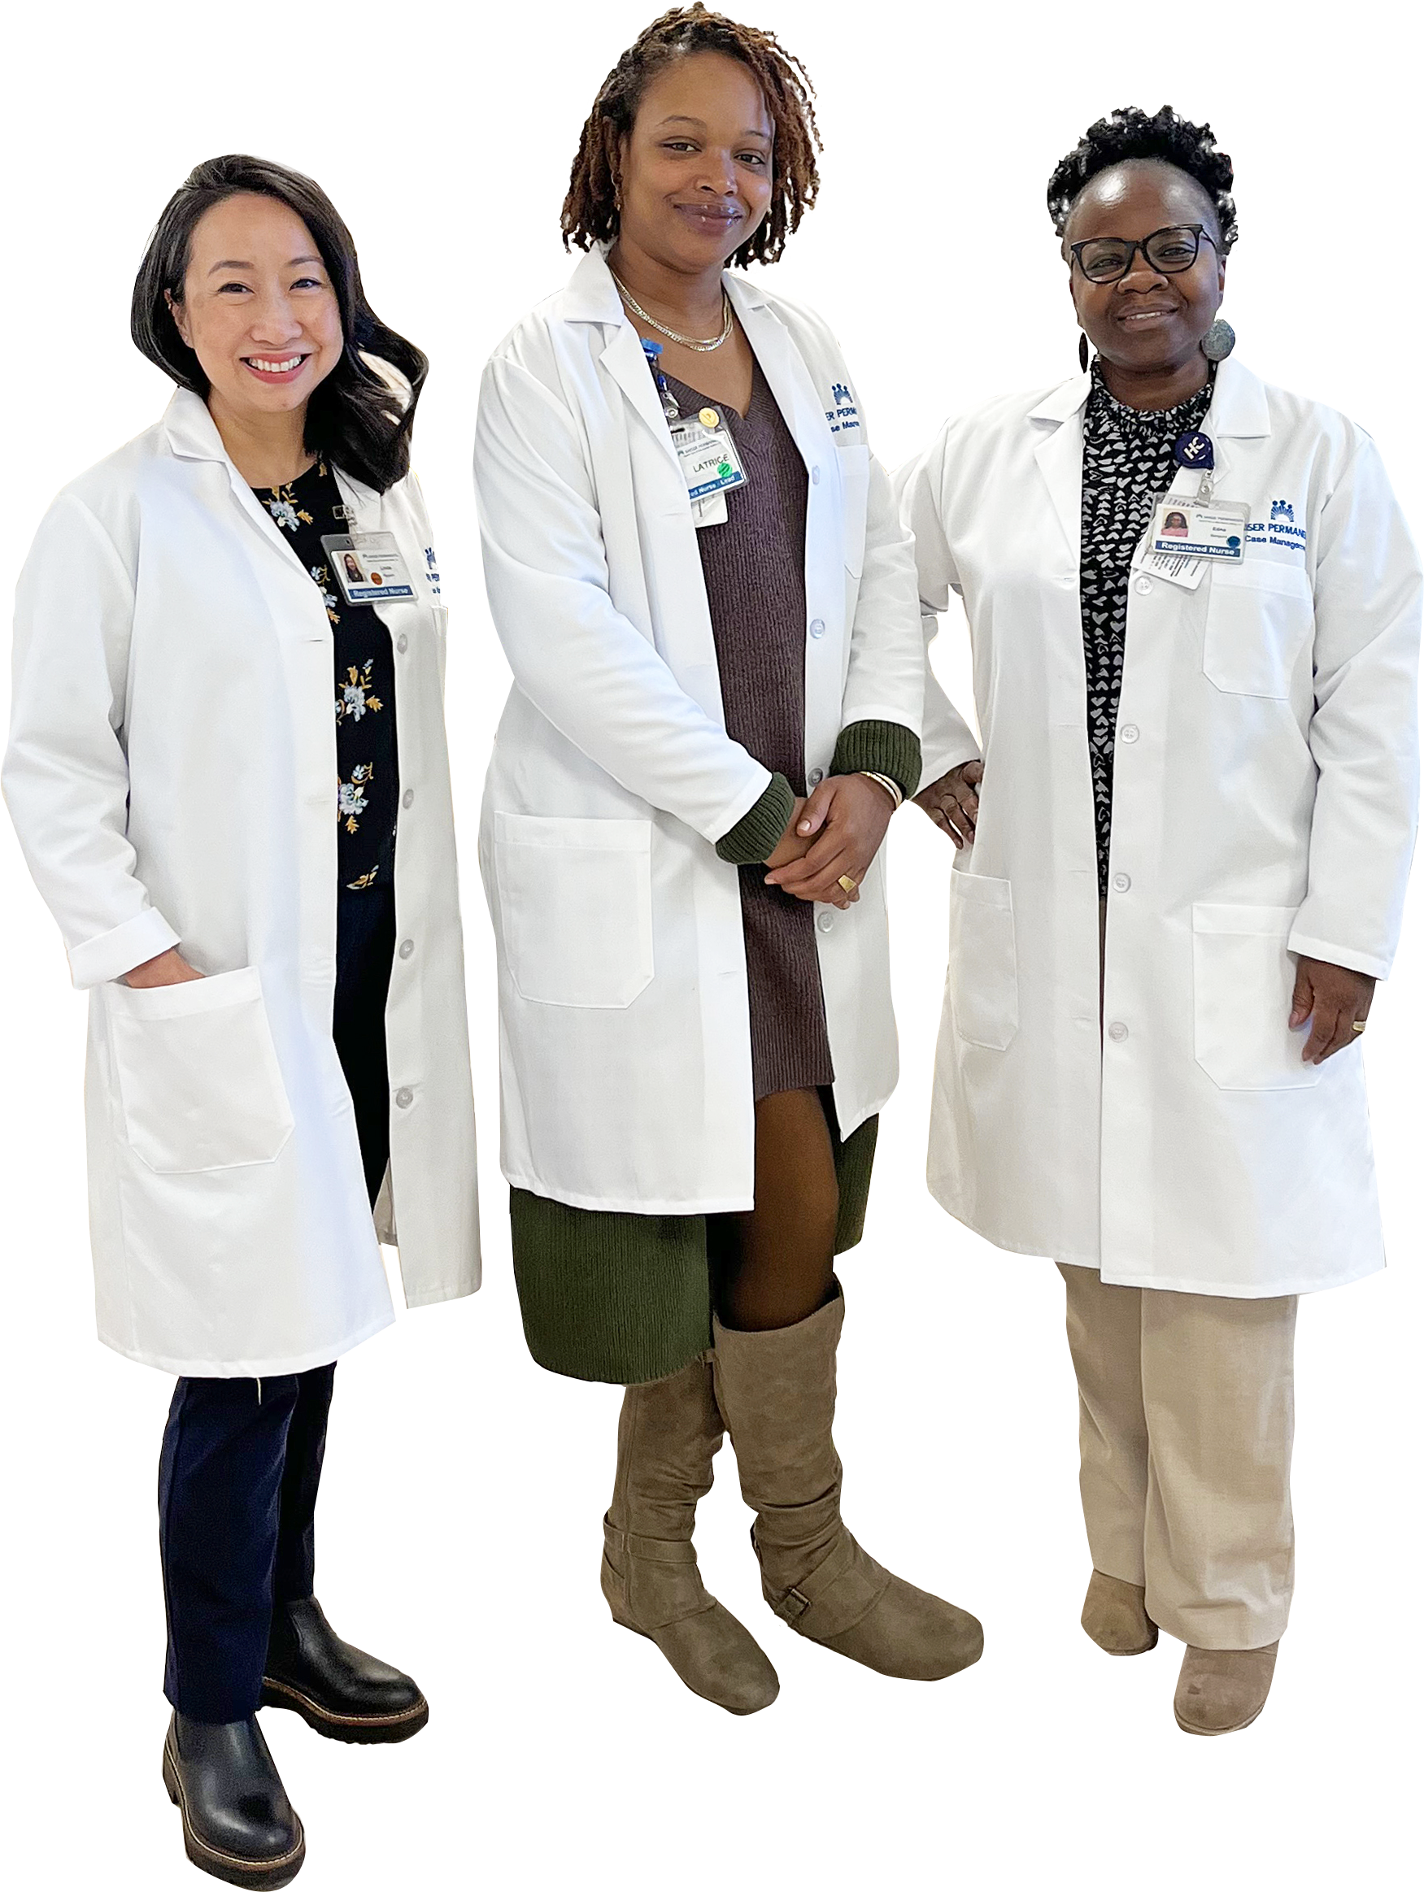
MID-ATLANTIC STATES
Delivering Right Care, Right Time:
Embedding patient care coordinators
in urgent care units helped to reduce
patient hospitalizations and emergency
room referrals, saving at least $3.1M
in 2023.
Notes:
Mid-Atlantic achieved $5.38 million in savings – 49% above target.
The biggest cost savings comes from the region’s Continuum of Care initiative, which embeds patient care coordinators in urgent care and advanced urgent care units to help reduce unnecessary hospitalizations and emergency room visits.
Begun in June 2023 as a pilot, the program has reduced the ‘Average Daily Transfer Rate’ from urgent care units to hospitals.
The project’s success is attracting attention. Urgent care units in other markets are looking to adopt a similar approach to reduce hospitalizations and emergency room referrals.
Looking ahead, the region plans to: Enhance collaboration with operational leaders to assist with affordability projects and align task force work with regional priorities.

Slide 43
MID-ATLANTIC STATES
Enhance collaboration with
operational leaders to assist
with affordability projects
Align task force work with
regional priorities
Notes:
Mid-Atlantic achieved $5.38 million in savings – 49% above target.
The biggest cost savings comes from the region’s Continuum of Care initiative, which embeds patient care coordinators in urgent care and advanced urgent care units to help reduce unnecessary hospitalizations and emergency room visits.
Begun in June 2023 as a pilot, the program has reduced the ‘Average Daily Transfer Rate’ from urgent care units to hospitals.
The project’s success is attracting attention. Urgent care units in other markets are looking to adopt a similar approach to reduce hospitalizations and emergency room referrals.
Looking ahead, the region plans to: Enhance collaboration with operational leaders to assist with affordability projects and align task force work with regional priorities.

Slide 44
NORTHWEST
REGION:
Notes:
The Northwest achieved $14.4 million in savings in 2023 – 122% above target.
Regional affordability initiatives include reducing overtime, improving attendance, and decreasing the average length of stay in skilled nursing facilities.
Unit-based team projects were especially fruitful. Here are 2 examples of outstanding UBT projects:
The Regional Telephonic Medicine Center team coordinates the return of patients to KP who receive emergency care in non-KP facilities once they are stabilized and ready for transport. Their efforts resulted in $1.1 million in savings in 2023.
At the Interstate Medical Office complex in Portland, nurses in the nurse treatment rooms review patient appointments 2 days in advance. This early prep work ensures medications and other supplies are adequately stocked and delays are minimized. Their contributions helped boost patient satisfaction and achieved $405,000 in savings in 2023.
Looking ahead this year, the Northwest plans to: Deepen partnership with operational leaders; develop rewards and recognition program; and refine success metrics for affordability initiatives.

Slide 45

NORTHWEST
Notes:
The Northwest achieved $14.4 million in savings in 2023 – 122% above target.
Regional affordability initiatives include reducing overtime, improving attendance, and decreasing the average length of stay in skilled nursing facilities.
Unit-based team projects were especially fruitful. Here are 2 examples of outstanding UBT projects:
The Regional Telephonic Medicine Center team coordinates the return of patients to KP who receive emergency care in non-KP facilities once they are stabilized and ready for transport. Their efforts resulted in $1.1 million in savings in 2023.
At the Interstate Medical Office complex in Portland, nurses in the nurse treatment rooms review patient appointments 2 days in advance. This early prep work ensures medications and other supplies are adequately stocked and delays are minimized. Their contributions helped boost patient satisfaction and achieved $405,000 in savings in 2023.
Looking ahead this year, the Northwest plans to: Deepen partnership with operational leaders; develop rewards and recognition program; and refine success metrics for affordability initiatives.

Slide 46
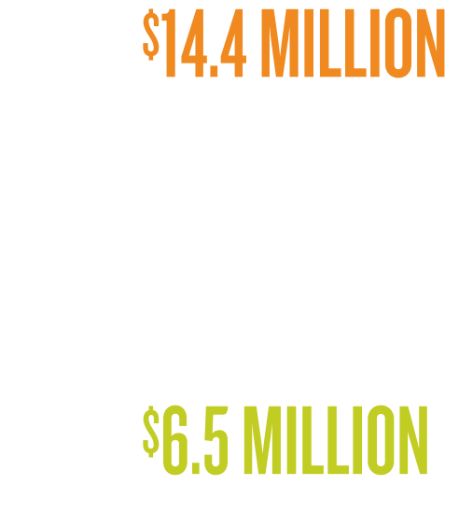
NORTHWEST
Notes:
The Northwest achieved $14.4 million in savings in 2023 – 122% above target.
Regional affordability initiatives include reducing overtime, improving attendance, and decreasing the average length of stay in skilled nursing facilities.
Unit-based team projects were especially fruitful. Here are 2 examples of outstanding UBT projects:
The Regional Telephonic Medicine Center team coordinates the return of patients to KP who receive emergency care in non-KP facilities once they are stabilized and ready for transport. Their efforts resulted in $1.1 million in savings in 2023.
At the Interstate Medical Office complex in Portland, nurses in the nurse treatment rooms review patient appointments 2 days in advance. This early prep work ensures medications and other supplies are adequately stocked and delays are minimized. Their contributions helped boost patient satisfaction and achieved $405,000 in savings in 2023.
Looking ahead this year, the Northwest plans to: Deepen partnership with operational leaders; develop rewards and recognition program; and refine success metrics for affordability initiatives.

Slide 47

NORTHWEST
Notes:
The Northwest achieved $14.4 million in savings in 2023 – 122% above target.
Regional affordability initiatives include reducing overtime, improving attendance, and decreasing the average length of stay in skilled nursing facilities.
Unit-based team projects were especially fruitful. Here are 2 examples of outstanding UBT projects:
The Regional Telephonic Medicine Center team coordinates the return of patients to KP who receive emergency care in non-KP facilities once they are stabilized and ready for transport. Their efforts resulted in $1.1 million in savings in 2023.
At the Interstate Medical Office complex in Portland, nurses in the nurse treatment rooms review patient appointments 2 days in advance. This early prep work ensures medications and other supplies are adequately stocked and delays are minimized. Their contributions helped boost patient satisfaction and achieved $405,000 in savings in 2023.
Looking ahead this year, the Northwest plans to: Deepen partnership with operational leaders; develop rewards and recognition program; and refine success metrics for affordability initiatives.

Slide 48

NORTHWEST
Notes:
The Northwest achieved $14.4 million in savings in 2023 – 122% above target.
Regional affordability initiatives include reducing overtime, improving attendance, and decreasing the average length of stay in skilled nursing facilities.
Unit-based team projects were especially fruitful. Here are 2 examples of outstanding UBT projects:
The Regional Telephonic Medicine Center team coordinates the return of patients to KP who receive emergency care in non-KP facilities once they are stabilized and ready for transport. Their efforts resulted in $1.1 million in savings in 2023.
At the Interstate Medical Office complex in Portland, nurses in the nurse treatment rooms review patient appointments 2 days in advance. This early prep work ensures medications and other supplies are adequately stocked and delays are minimized. Their contributions helped boost patient satisfaction and achieved $405,000 in savings in 2023.
Looking ahead this year, the Northwest plans to: Deepen partnership with operational leaders; develop rewards and recognition program; and refine success metrics for affordability initiatives.

Slide 49

NORTHWEST
Notes:
The Northwest achieved $14.4 million in savings in 2023 – 122% above target.
Regional affordability initiatives include reducing overtime, improving attendance, and decreasing the average length of stay in skilled nursing facilities.
Unit-based team projects were especially fruitful. Here are 2 examples of outstanding UBT projects:
The Regional Telephonic Medicine Center team coordinates the return of patients to KP who receive emergency care in non-KP facilities once they are stabilized and ready for transport. Their efforts resulted in $1.1 million in savings in 2023.
At the Interstate Medical Office complex in Portland, nurses in the nurse treatment rooms review patient appointments 2 days in advance. This early prep work ensures medications and other supplies are adequately stocked and delays are minimized. Their contributions helped boost patient satisfaction and achieved $405,000 in savings in 2023.
Looking ahead this year, the Northwest plans to: Deepen partnership with operational leaders; develop rewards and recognition program; and refine success metrics for affordability initiatives.

Slide 50

NORTHWEST
Notes:
The Northwest achieved $14.4 million in savings in 2023 – 122% above target.
Regional affordability initiatives include reducing overtime, improving attendance, and decreasing the average length of stay in skilled nursing facilities.
Unit-based team projects were especially fruitful. Here are 2 examples of outstanding UBT projects:
The Regional Telephonic Medicine Center team coordinates the return of patients to KP who receive emergency care in non-KP facilities once they are stabilized and ready for transport. Their efforts resulted in $1.1 million in savings in 2023.
At the Interstate Medical Office complex in Portland, nurses in the nurse treatment rooms review patient appointments 2 days in advance. This early prep work ensures medications and other supplies are adequately stocked and delays are minimized. Their contributions helped boost patient satisfaction and achieved $405,000 in savings in 2023.
Looking ahead this year, the Northwest plans to: Deepen partnership with operational leaders; develop rewards and recognition program; and refine success metrics for affordability initiatives.

Slide 51

NORTHWEST
Ensuring Quality Care:
Regional Telephonic Medicine Center
UBT coordinates the return of KP
patients receiving emergency care in
non-KP facilities. Efforts resulted in
$1.1M in savings in 2023.
Notes:
The Northwest achieved $14.4 million in savings in 2023 – 122% above target.
Regional affordability initiatives include reducing overtime, improving attendance, and decreasing the average length of stay in skilled nursing facilities.
Unit-based team projects were especially fruitful. Here are 2 examples of outstanding UBT projects:
The Regional Telephonic Medicine Center team coordinates the return of patients to KP who receive emergency care in non-KP facilities once they are stabilized and ready for transport. Their efforts resulted in $1.1 million in savings in 2023.
At the Interstate Medical Office complex in Portland, nurses in the nurse treatment rooms review patient appointments 2 days in advance. This early prep work ensures medications and other supplies are adequately stocked and delays are minimized. Their contributions helped boost patient satisfaction and achieved $405,000 in savings in 2023.
Looking ahead this year, the Northwest plans to: Deepen partnership with operational leaders; develop rewards and recognition program; and refine success metrics for affordability initiatives.

Slide 52
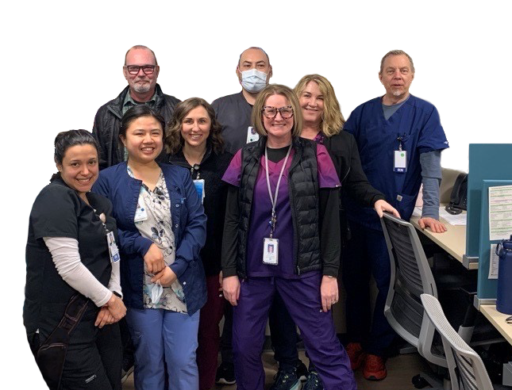
NORTHWEST
Improving Patient Care in Advance:
Nurses in high-traffic nurse treatment
rooms (pictured) review appointments
2 days in advance to ensure supplies
are adequately stocked and delays
are minimized. Efforts led to higher
patient satisfaction and $405K in
savings in 2023.
Notes:
The Northwest achieved $14.4 million in savings in 2023 – 122% above target.
Regional affordability initiatives include reducing overtime, improving attendance, and decreasing the average length of stay in skilled nursing facilities.
Unit-based team projects were especially fruitful. Here are 2 examples of outstanding UBT projects:
The Regional Telephonic Medicine Center team coordinates the return of patients to KP who receive emergency care in non-KP facilities once they are stabilized and ready for transport. Their efforts resulted in $1.1 million in savings in 2023.
At the Interstate Medical Office complex in Portland, nurses in the nurse treatment rooms review patient appointments 2 days in advance. This early prep work ensures medications and other supplies are adequately stocked and delays are minimized. Their contributions helped boost patient satisfaction and achieved $405,000 in savings in 2023.
Looking ahead this year, the Northwest plans to: Deepen partnership with operational leaders; develop rewards and recognition program; and refine success metrics for affordability initiatives.

Slide 53
NORTHWEST
Deepen partnership with
operational leaders
Develop rewards and
recognition program
Refine success metrics for
affordability initiatives
Notes:
The Northwest achieved $14.4 million in savings in 2023 – 122% above target.
Regional affordability initiatives include reducing overtime, improving attendance, and decreasing the average length of stay in skilled nursing facilities.
Unit-based team projects were especially fruitful. Here are 2 examples of outstanding UBT projects:
The Regional Telephonic Medicine Center team coordinates the return of patients to KP who receive emergency care in non-KP facilities once they are stabilized and ready for transport. Their efforts resulted in $1.1 million in savings in 2023.
At the Interstate Medical Office complex in Portland, nurses in the nurse treatment rooms review patient appointments 2 days in advance. This early prep work ensures medications and other supplies are adequately stocked and delays are minimized. Their contributions helped boost patient satisfaction and achieved $405,000 in savings in 2023.
Looking ahead this year, the Northwest plans to: Deepen partnership with operational leaders; develop rewards and recognition program; and refine success metrics for affordability initiatives.

Slide 54
SOUTHERN
CALIFORNIA
REGION:
Notes:
Southern California achieved $72.95 million in savings – 29% above target.
Regional affordability efforts include reducing external Covid testing, achieving cost savings from unit-based team affordability projects, converting from Humira® to Amjevita™, and improving attendance.
Southern California’s achievement included nearly $24 million in savings through more than 800 individual unit-based team projects involving Alliance union members. Projects focused on affordability, attendance, quality, safety, and service.
Looking ahead this year, the region plans to: Continue efforts to improve attendance, pursue pharmacy savings, bolster the Care Without Delay initiative, and expand and improve its Return-On-Investment vetting process for UBT affordability projects.

Slide 55

SOUTHERN CALIFORNIA
Notes:
Southern California achieved $72.95 million in savings – 29% above target.
Regional affordability efforts include reducing external Covid testing, achieving cost savings from unit-based team affordability projects, converting from Humira® to Amjevita™, and improving attendance.
Southern California’s achievement included nearly $24 million in savings through more than 800 individual unit-based team projects involving Alliance union members. Projects focused on affordability, attendance, quality, safety, and service.
Looking ahead this year, the region plans to: Continue efforts to improve attendance, pursue pharmacy savings, bolster the Care Without Delay initiative, and expand and improve its Return-On-Investment vetting process for UBT affordability projects.

Slide 56
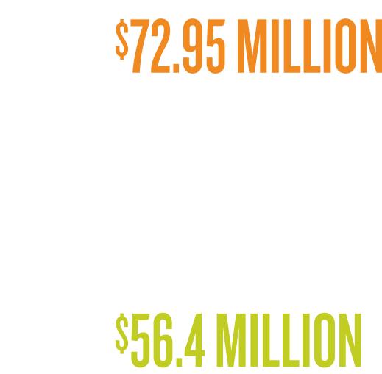
SOUTHERN CALIFORNIA
Notes:
Southern California achieved $72.95 million in savings – 29% above target.
Regional affordability efforts include reducing external Covid testing, achieving cost savings from unit-based team affordability projects, converting from Humira® to Amjevita™, and improving attendance.
Southern California’s achievement included nearly $24 million in savings through more than 800 individual unit-based team projects involving Alliance union members. Projects focused on affordability, attendance, quality, safety, and service.
Looking ahead this year, the region plans to: Continue efforts to improve attendance, pursue pharmacy savings, bolster the Care Without Delay initiative, and expand and improve its Return-On-Investment vetting process for UBT affordability projects.

Slide 57

SOUTHERN CALIFORNIA
Notes:
Southern California achieved $72.95 million in savings – 29% above target.
Regional affordability efforts include reducing external Covid testing, achieving cost savings from unit-based team affordability projects, converting from Humira® to Amjevita™, and improving attendance.
Southern California’s achievement included nearly $24 million in savings through more than 800 individual unit-based team projects involving Alliance union members. Projects focused on affordability, attendance, quality, safety, and service.
Looking ahead this year, the region plans to: Continue efforts to improve attendance, pursue pharmacy savings, bolster the Care Without Delay initiative, and expand and improve its Return-On-Investment vetting process for UBT affordability projects.

Slide 58

SOUTHERN CALIFORNIA
Notes:
Southern California achieved $72.95 million in savings – 29% above target.
Regional affordability efforts include reducing external Covid testing, achieving cost savings from unit-based team affordability projects, converting from Humira® to Amjevita™, and improving attendance.
Southern California’s achievement included nearly $24 million in savings through more than 800 individual unit-based team projects involving Alliance union members. Projects focused on affordability, attendance, quality, safety, and service.
Looking ahead this year, the region plans to: Continue efforts to improve attendance, pursue pharmacy savings, bolster the Care Without Delay initiative, and expand and improve its Return-On-Investment vetting process for UBT affordability projects.

Slide 59

SOUTHERN CALIFORNIA
Notes:
Southern California achieved $72.95 million in savings – 29% above target.
Regional affordability efforts include reducing external Covid testing, achieving cost savings from unit-based team affordability projects, converting from Humira® to Amjevita™, and improving attendance.
Southern California’s achievement included nearly $24 million in savings through more than 800 individual unit-based team projects involving Alliance union members. Projects focused on affordability, attendance, quality, safety, and service.
Looking ahead this year, the region plans to: Continue efforts to improve attendance, pursue pharmacy savings, bolster the Care Without Delay initiative, and expand and improve its Return-On-Investment vetting process for UBT affordability projects.

Slide 60

SOUTHERN CALIFORNIA
Notes:
Southern California achieved $72.95 million in savings – 29% above target.
Regional affordability efforts include reducing external Covid testing, achieving cost savings from unit-based team affordability projects, converting from Humira® to Amjevita™, and improving attendance.
Southern California’s achievement included nearly $24 million in savings through more than 800 individual unit-based team projects involving Alliance union members. Projects focused on affordability, attendance, quality, safety, and service.
Looking ahead this year, the region plans to: Continue efforts to improve attendance, pursue pharmacy savings, bolster the Care Without Delay initiative, and expand and improve its Return-On-Investment vetting process for UBT affordability projects.

Slide 61
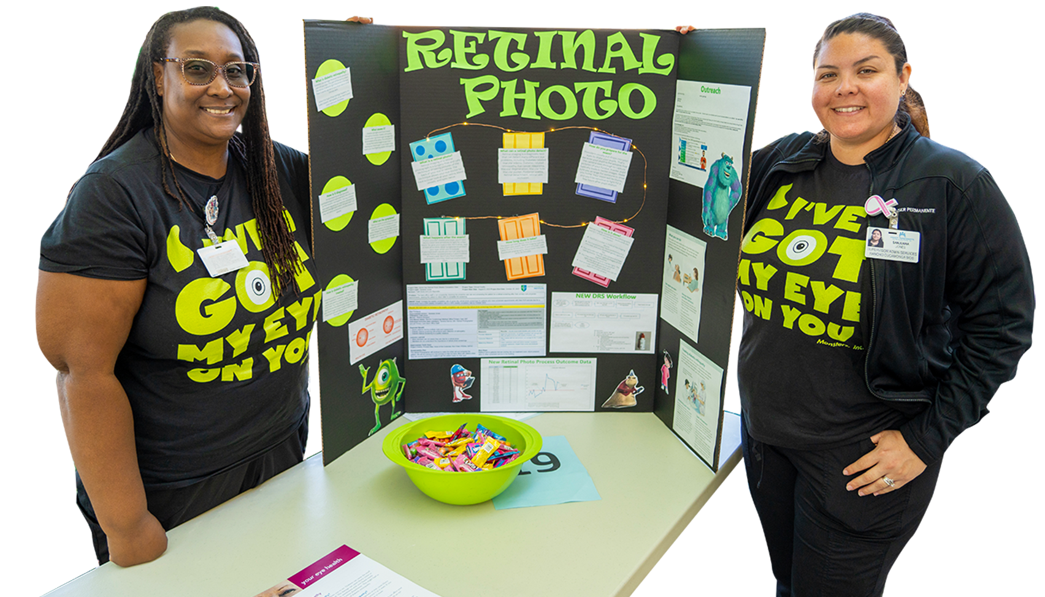
SOUTHERN CALIFORNIA
UBT affordability projects: Alliance
members took part in over 800 UBT
affordability projects that contributed
to savings totaling $23.8M. Projects
focused on affordability, attendance,
quality, safety and service.
Notes:
Southern California achieved $72.95 million in savings – 29% above target.
Regional affordability efforts include reducing external Covid testing, achieving cost savings from unit-based team affordability projects, converting from Humira® to Amjevita™, and improving attendance.
Southern California’s achievement included nearly $24 million in savings through more than 800 individual unit-based team projects involving Alliance union members. Projects focused on affordability, attendance, quality, safety, and service.
Looking ahead this year, the region plans to: Continue efforts to improve attendance, pursue pharmacy savings, bolster the Care Without Delay initiative, and expand and improve its Return-On-Investment vetting process for UBT affordability projects.

Slide 62
SOUTHERN CALIFORNIA
Continue efforts to improve attendance
and pharmacy savings
Bolster “Care Without Delay” initiative
Expand and improve ROI vetting
process for UBT affordability
projects
Notes:
Southern California achieved $72.95 million in savings – 29% above target.
Regional affordability efforts include reducing external Covid testing, achieving cost savings from unit-based team affordability projects, converting from Humira® to Amjevita™, and improving attendance.
Southern California’s achievement included nearly $24 million in savings through more than 800 individual unit-based team projects involving Alliance union members. Projects focused on affordability, attendance, quality, safety, and service.
Looking ahead this year, the region plans to: Continue efforts to improve attendance, pursue pharmacy savings, bolster the Care Without Delay initiative, and expand and improve its Return-On-Investment vetting process for UBT affordability projects.

Slide 63
WASHINGTON
REGION:
Notes:
The region achieved $6 million in savings in 2023 – 21% above target.
Washington is one of 3 regional task forces to accrue significant savings from converting to Amjevita™, a biosimilar that is significantly less expensive than Humira®, with the same safety and efficacy for treating inflammatory disease.
Biosimilars are competitors to complex biologic drugs like Humira that are made inside living cells. KP has overseen several biosimilar conversions over the past decade.
While KP set a 80%“conversion rate” for Amjevita™ in 2023, efforts by regional task forces have helped push that rate above 90% in some markets. Those additional conversions are resulting in cost savings that can be applied to the Alliance PSP affordability goal.
Washington is especially well suited for this project because half of the region’s Alliance-represented employees work in pharmacy.
Looking ahead this year, the region plans to: Pursue new cost-savings opportunities and continue efforts to energize the region’s fledgling unit-based teams.

Slide 64

WASHINGTON
Notes:
The region achieved $6 million in savings in 2023 – 21% above target.
Washington is one of 3 regional task forces to accrue significant savings from converting to Amjevita™, a biosimilar that is significantly less expensive than Humira®, with the same safety and efficacy for treating inflammatory disease.
Biosimilars are competitors to complex biologic drugs like Humira that are made inside living cells. KP has overseen several biosimilar conversions over the past decade.
While KP set a 80%“conversion rate” for Amjevita™ in 2023, efforts by regional task forces have helped push that rate above 90% in some markets. Those additional conversions are resulting in cost savings that can be applied to the Alliance PSP affordability goal.
Washington is especially well suited for this project because half of the region’s Alliance-represented employees work in pharmacy.
Looking ahead this year, the region plans to: Pursue new cost-savings opportunities and continue efforts to energize the region’s fledgling unit-based teams.

Slide 65
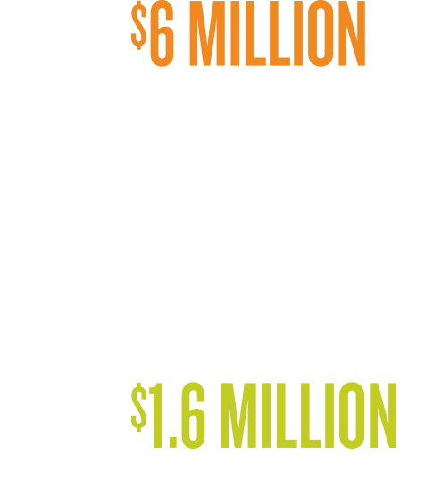
WASHINGTON
Notes:
The region achieved $6 million in savings in 2023 – 21% above target.
Washington is one of 3 regional task forces to accrue significant savings from converting to Amjevita™, a biosimilar that is significantly less expensive than Humira®, with the same safety and efficacy for treating inflammatory disease.
Biosimilars are competitors to complex biologic drugs like Humira that are made inside living cells. KP has overseen several biosimilar conversions over the past decade.
While KP set a 80%“conversion rate” for Amjevita™ in 2023, efforts by regional task forces have helped push that rate above 90% in some markets. Those additional conversions are resulting in cost savings that can be applied to the Alliance PSP affordability goal.
Washington is especially well suited for this project because half of the region’s Alliance-represented employees work in pharmacy.
Looking ahead this year, the region plans to: Pursue new cost-savings opportunities and continue efforts to energize the region’s fledgling unit-based teams.

Slide 66

WASHINGTON
Notes:
The region achieved $6 million in savings in 2023 – 21% above target.
Washington is one of 3 regional task forces to accrue significant savings from converting to Amjevita™, a biosimilar that is significantly less expensive than Humira®, with the same safety and efficacy for treating inflammatory disease.
Biosimilars are competitors to complex biologic drugs like Humira that are made inside living cells. KP has overseen several biosimilar conversions over the past decade.
While KP set a 80%“conversion rate” for Amjevita™ in 2023, efforts by regional task forces have helped push that rate above 90% in some markets. Those additional conversions are resulting in cost savings that can be applied to the Alliance PSP affordability goal.
Washington is especially well suited for this project because half of the region’s Alliance-represented employees work in pharmacy.
Looking ahead this year, the region plans to: Pursue new cost-savings opportunities and continue efforts to energize the region’s fledgling unit-based teams.

Slide 67

WASHINGTON
Notes:
The region achieved $6 million in savings in 2023 – 21% above target.
Washington is one of 3 regional task forces to accrue significant savings from converting to Amjevita™, a biosimilar that is significantly less expensive than Humira®, with the same safety and efficacy for treating inflammatory disease.
Biosimilars are competitors to complex biologic drugs like Humira that are made inside living cells. KP has overseen several biosimilar conversions over the past decade.
While KP set a 80%“conversion rate” for Amjevita™ in 2023, efforts by regional task forces have helped push that rate above 90% in some markets. Those additional conversions are resulting in cost savings that can be applied to the Alliance PSP affordability goal.
Washington is especially well suited for this project because half of the region’s Alliance-represented employees work in pharmacy.
Looking ahead this year, the region plans to: Pursue new cost-savings opportunities and continue efforts to energize the region’s fledgling unit-based teams.

Slide 68

WASHINGTON
Converting to Amjevita™:
Nearly half of Alliance staff work in
pharmacies, making the region
well-positioned to leverage conversion
to Amjevita™, a cost-effective biosimilar
approved for use in the U.S.
Notes:
The region achieved $6 million in savings in 2023 – 21% above target.
Washington is one of 3 regional task forces to accrue significant savings from converting to Amjevita™, a biosimilar that is significantly less expensive than Humira®, with the same safety and efficacy for treating inflammatory disease.
Biosimilars are competitors to complex biologic drugs like Humira that are made inside living cells. KP has overseen several biosimilar conversions over the past decade.
While KP set a 80%“conversion rate” for Amjevita™ in 2023, efforts by regional task forces have helped push that rate above 90% in some markets. Those additional conversions are resulting in cost savings that can be applied to the Alliance PSP affordability goal.
Washington is especially well suited for this project because half of the region’s Alliance-represented employees work in pharmacy.
Looking ahead this year, the region plans to: Pursue new cost-savings opportunities and continue efforts to energize the region’s fledgling unit-based teams.

Slide 69
WASHINGTON
Explore cost-savings opportunities
beyond the Amjevita™ initiative
Continue efforts to nurture and
establish unit-based teams
Notes:
The region achieved $6 million in savings in 2023 – 21% above target.
Washington is one of 3 regional task forces to accrue significant savings from converting to Amjevita™, a biosimilar that is significantly less expensive than Humira®, with the same safety and efficacy for treating inflammatory disease.
Biosimilars are competitors to complex biologic drugs like Humira that are made inside living cells. KP has overseen several biosimilar conversions over the past decade.
While KP set a 80%“conversion rate” for Amjevita™ in 2023, efforts by regional task forces have helped push that rate above 90% in some markets. Those additional conversions are resulting in cost savings that can be applied to the Alliance PSP affordability goal.
Washington is especially well suited for this project because half of the region’s Alliance-represented employees work in pharmacy.
Looking ahead this year, the region plans to: Pursue new cost-savings opportunities and continue efforts to energize the region’s fledgling unit-based teams.

Slide 70
2023
YEAR-END
REPORT
National Affordability and Competitiveness Task Force
MARCH 2024

