Slide 1
Keeping KP Affordable and Competitive
How unit-based teams are saving money for Kaiser Permanente
DATE 2024
Notes:
You know all about the challenges ahead of us when it comes to keeping KP affordable for the members and communities we serve. They are daunting! But the good news is, we have the tools to achieve our goals.
In 2021, KP and the Alliance of Health Care Unions pledged to work together to
explore factors impacting KP’s success
identify cost savings and efficiencies
and secure a successful long-term future for Kaiser Permanente, our workers, and patients
And there is even better news: We have a secret weapon that our competitors do not: Our Labor Management Partnership and unit-based teams.
Over the last 25 years, we’ve built a culture of listening to the voices of the frontline. The people at the frontline know best how our work is done, and they know where the opportunities are to increase efficiency and save money. And, thanks to rigorous training and constant communication, they have the knowledge and skills to improve performance.
We know this because they are already doing it:

Slide 2
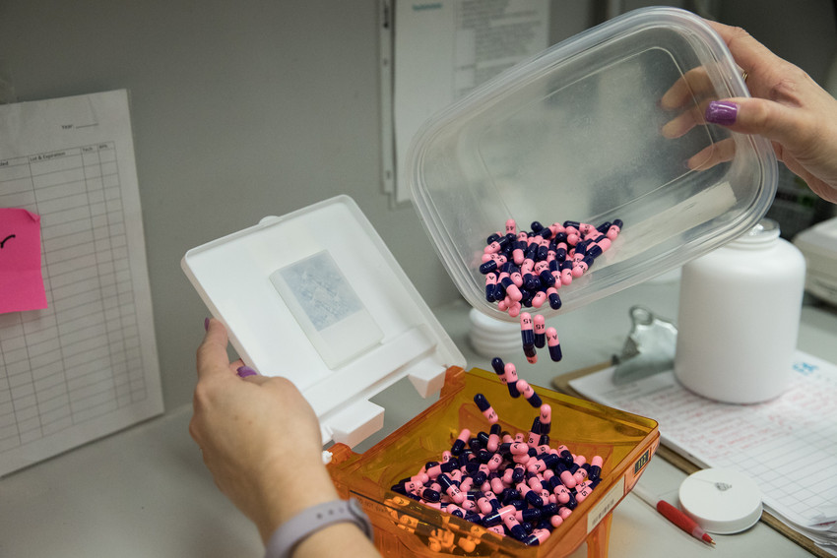
Pharmacy team saves $108,000
This team worked with its analytics colleagues to identify KP members filling high-cost medications outside KP pharmacies.
Pharmacy technicians reached out to those members to explain the benefits of prescription delivery options and helped them transfer their prescriptions to KP.
Cost-savings: $108,000
Notes:
For example, this pharmacy team saved over one hundred thousand dollars with outreach to patients using high-cost drugs.
[For reference: URL for this TTP is:
https://www.lmpartnership.org/team-tested-practices/pharmacy-team-discovers-big-savings-through-prescription-transfers]

Slide 3
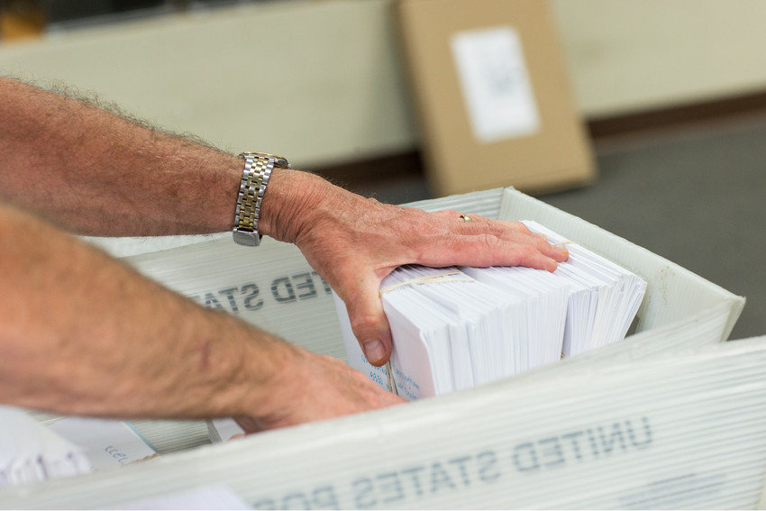
Appointment center saves $5,000 a year
Clerks at an appointment center got permission to use KP HealthConnect® to email patients securely (something normally only doctors and nurses did) instead of relying on phone calls and snail mail.
In 2 weeks, the team reduced the volume of mail by 151 letters per week. That put them on track to save $5,000 in mailing supplies a year.
Cost Savings: $5,000 annually
Notes:
Another team figured out a way to use technology to save money on mailing.
[URL is https://www.lmpartnership.org/team-tested-practices/emails-lick-stamps-and-envelopes-savings]

Slide 4
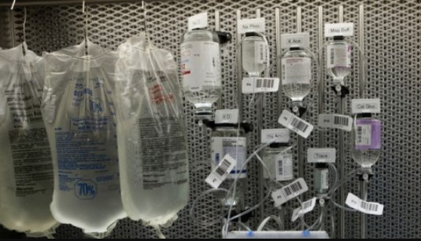
Oncology team saves $25,000 a year
This team used less costly secondary tubing (when it was medically safe to do so) instead of more expensive primary tubing when administering IV medication.
Cost savings: $25,000 annually
Notes:
An oncology team saved money using less-expensive tubing (only when it was medically appropriate, of course)
[URL for this is https://www.lmpartnership.org/stories/change-tubing-saves-25000]

Slide 5
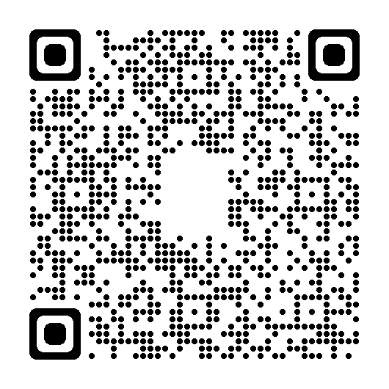
More Examples on LMPartnership.org
Scan this QR code with your smart phone camera to explore more UBT affordability projects on the Team-Tested Practices section of the LMP website.
Notes:
There are more examples of the ways UBTs have saved money on the LMP website. Browse through them on the Team-Tested Practices section by scanning this QR code.

Slide 6

More Examples in UBT Tracker
Log on to HRConnect
Navigate to Work @ KP
Labor & LMP
UBT Tracker
Search projects
Advanced search
In the Value Compass area, choose “Most Affordable”
Notes:
For even more examples, go to UBT Tracker.

Slide 7
TIPS AND TOOLS

Slide 8
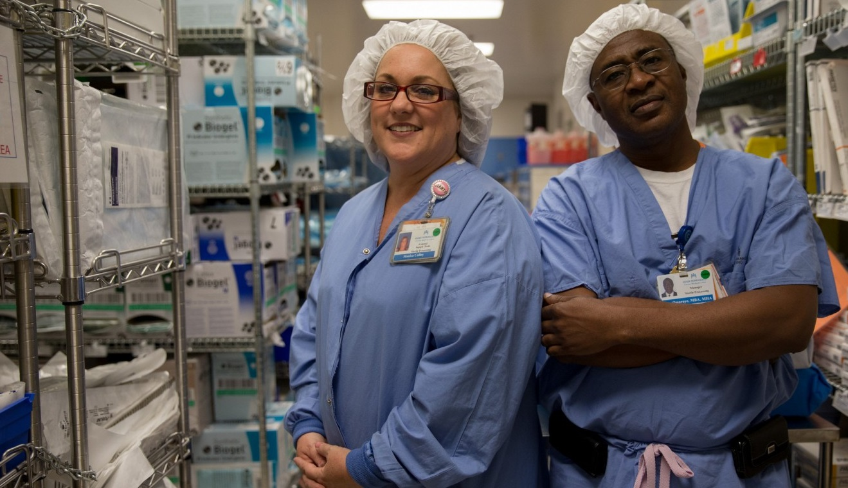
Tips for Reducing Supply Waste
Create an opportunity for everyone in the department to give input about how often different supplies get used, so you don’t eliminate something the department needs.
Organize the supplies by figuring out where each item belongs and then labeling supplies and shelves. Also set “par” levels, figuring out the quantity the department should always have on hand.

Slide 9
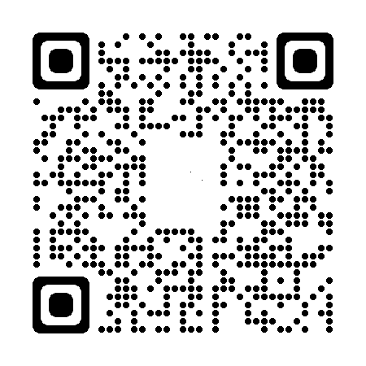
Tips for Reducing Supply Waste
Establish a signal for when supplies need to be re-ordered. And have a system for alerting people when an item is getting close to its expiration date.
Scan the QR code for more tips

Slide 10
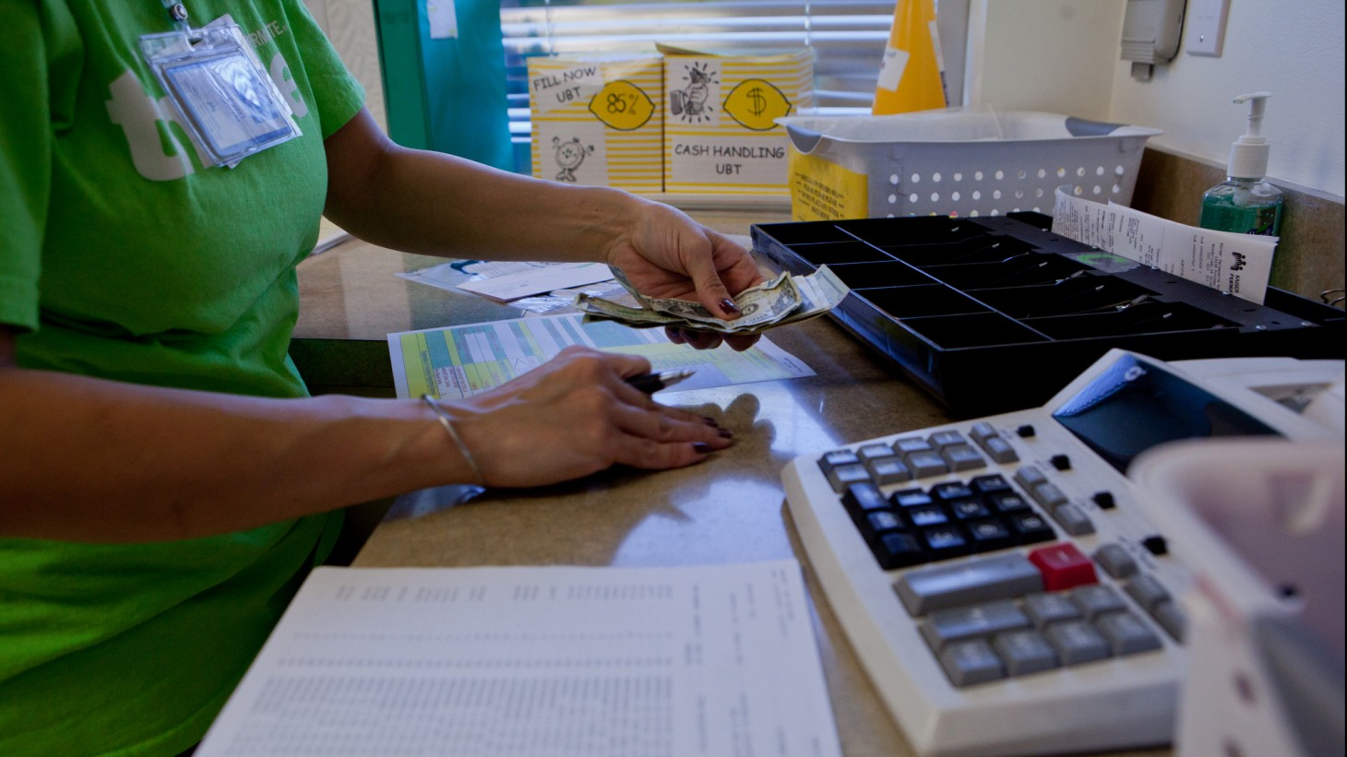
Tips for Tracking Financial Impact
Think about potential financial impact from the start of your project. This will help you identify early on the data to collect and monitor so the financial impact can be calculated later.
Understand your baseline metric. Once you know what your goal is, determine the associated costs before any changes are made. This will help you translate the improvement into money saved.

Slide 11
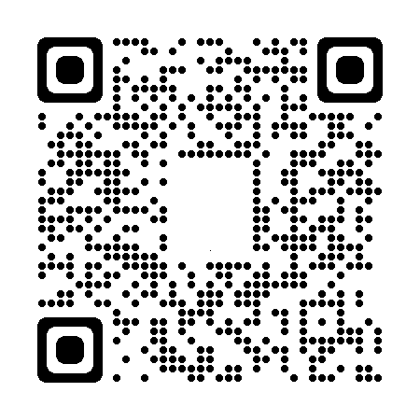
Tips for Tracking Financial Impact
Think about the cost associated with the staffing crisis. For instance, if your goal is to streamline scheduling, think about the potential costs, such as excessive overtime, associated with an inefficient schedule.
Scan the QR code for more tips

Slide 12
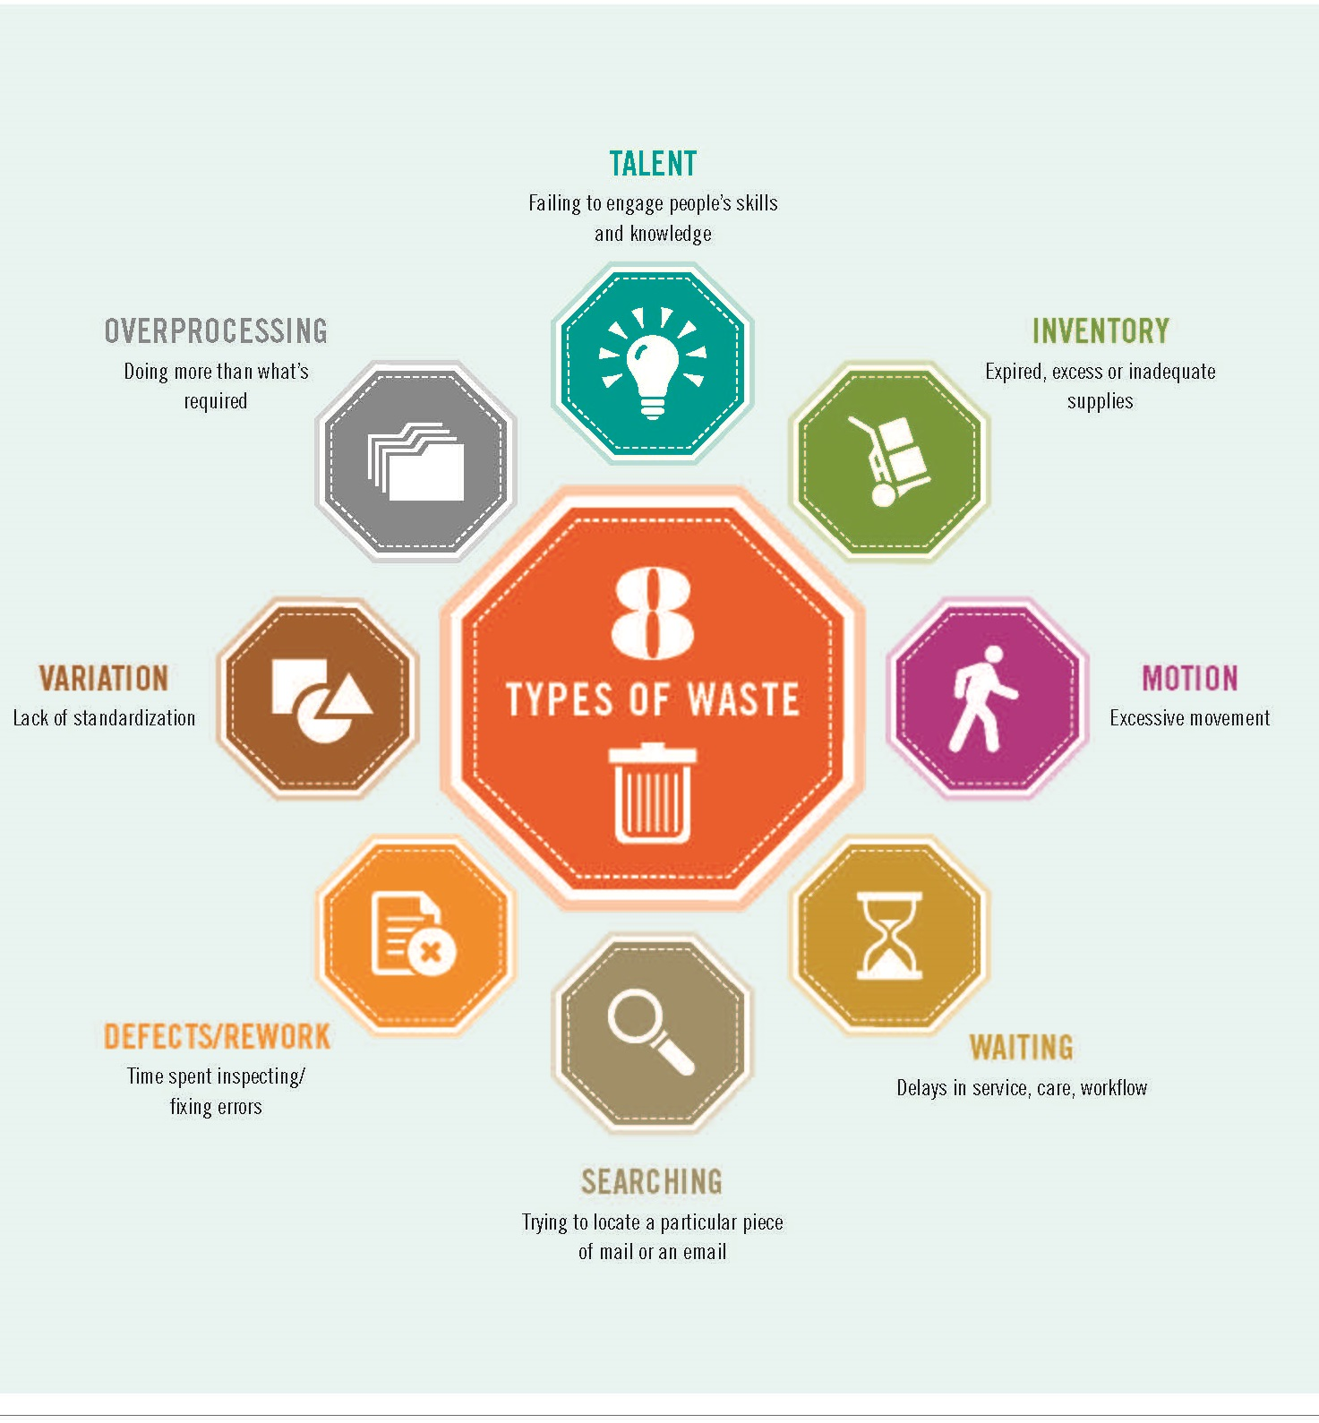
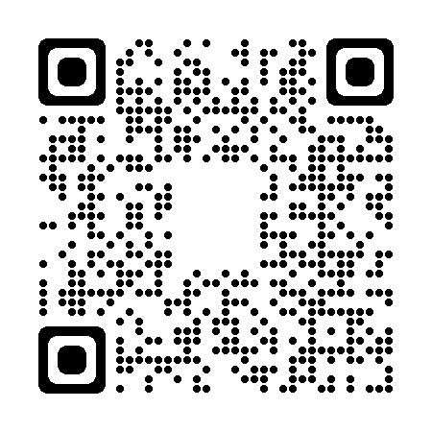
Download the Waste Walk How-to Guide
Scan the QR code to see
the How-to Guide
Notes:
Doing a waste walk is the best way to identify waste in a department. Our toolkit includes a video, step-by-step instructions and observation checklists.
[URL is https://www.lmpartnership.org/how-to-guide/do-waste-walk]

Slide 13
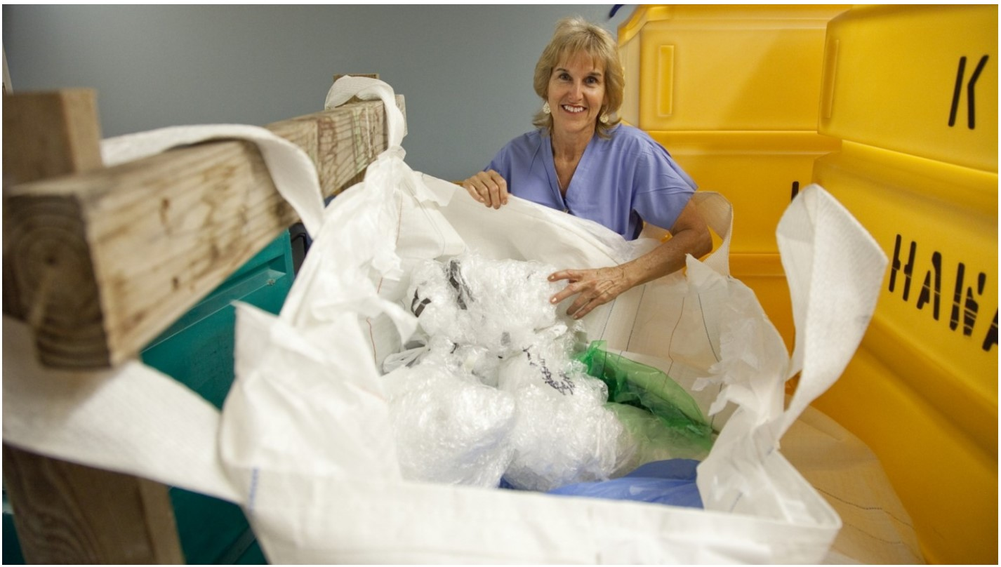
General Principles for UBT Affordability Projects
Notes:
When we look at successful affordability projects, we start to see patterns emerge. No matter the market or type of department, there are a few general principles that pop up again and again.

Slide 14
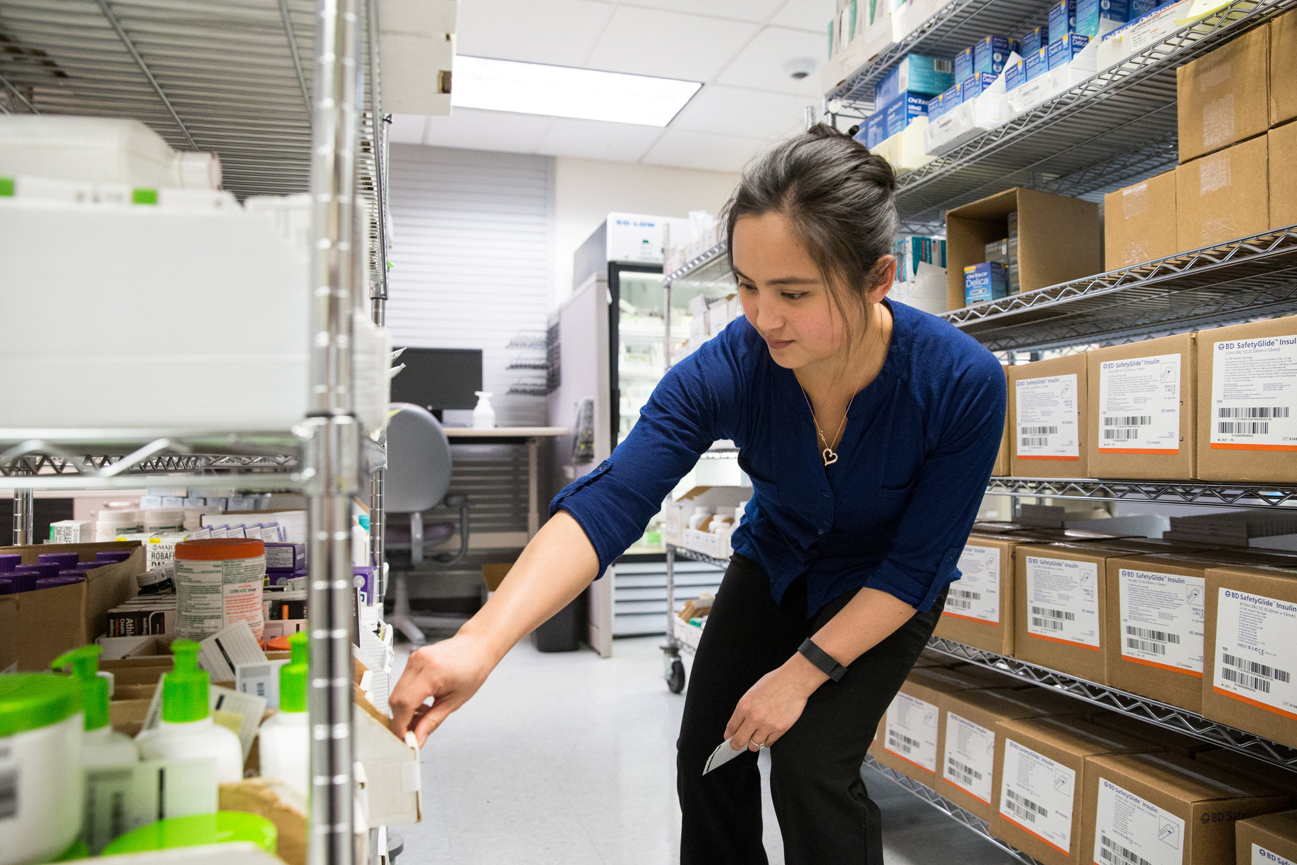
How might we reduce costs?
Standardize supply storage and ordering
Reduce demand for STAT orders
Reduce variation in supply ordering
Internalize testing and other services
Notes:
A phrase we use a lot in our Partnership work is, “how might we…?” It’s an invitation to brainstorm possibilities. We say that during bargaining and during performance improvement projects.
So, for our affordability work, we could start with, “how might we… reduce variation in supplies …”

Slide 15
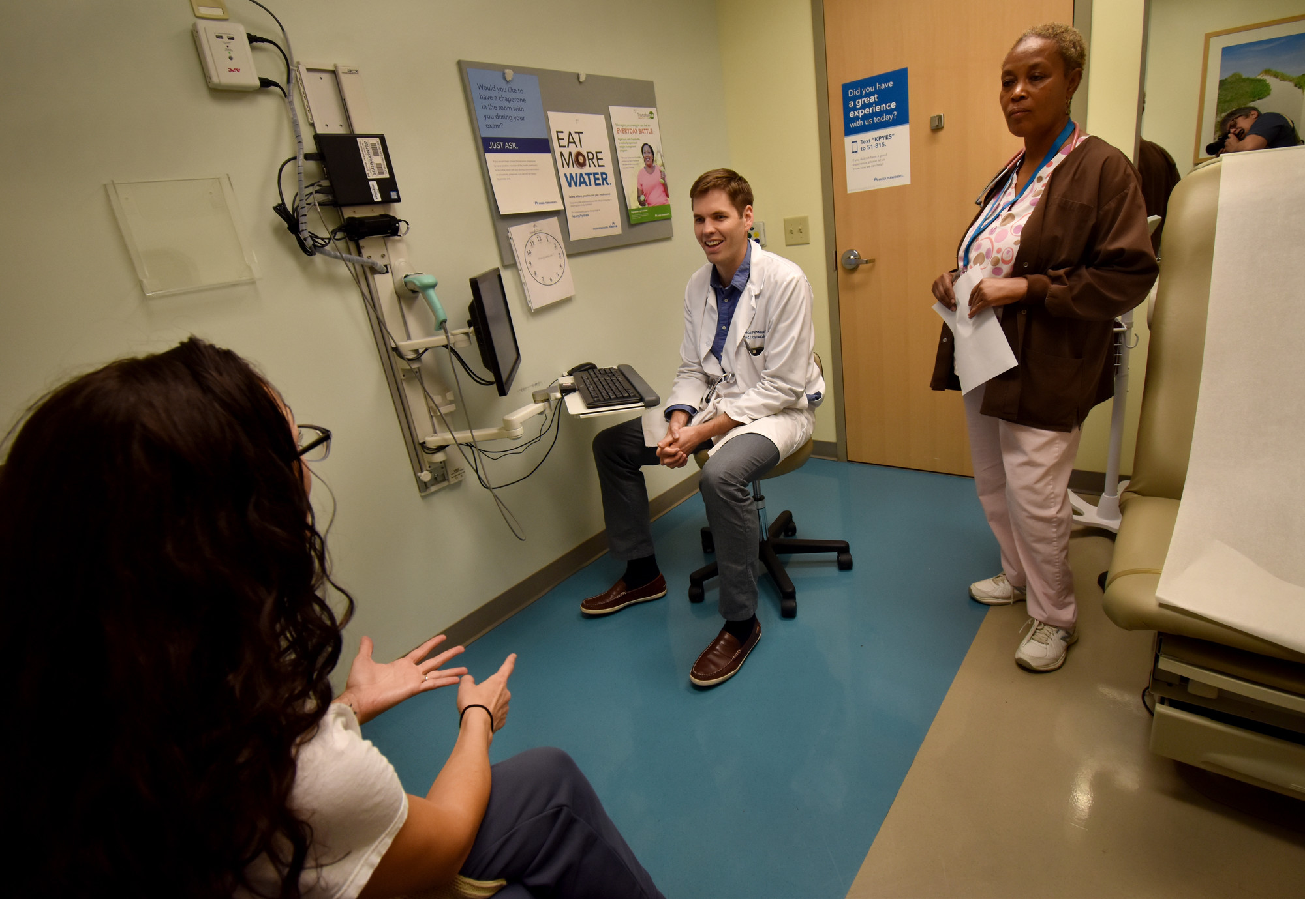
How might we increase efficiency?
Reduce re-work caused by incomplete information
Reduce error rate in processes
Use templates to reduce documentation time
Reduce readmissions

Slide 16
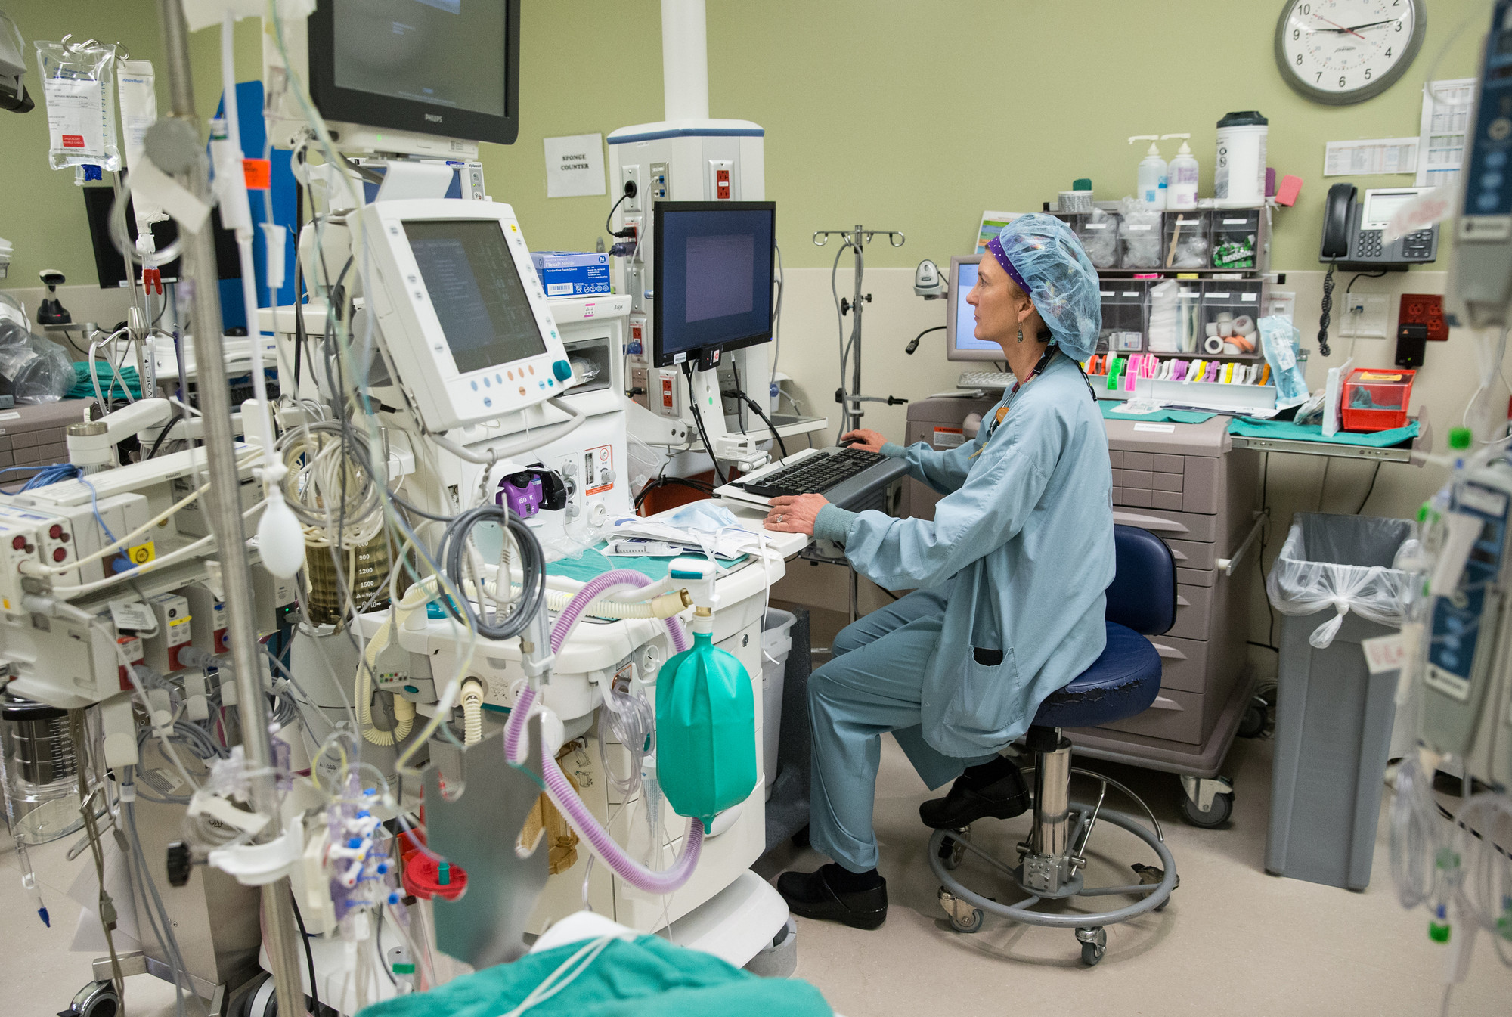
How might we improve hospital patient flow?
Ensure on-time surgical starts
Improve operating room turnaround times
Reduce transport delays
Integrate transport and lift teams

Slide 17
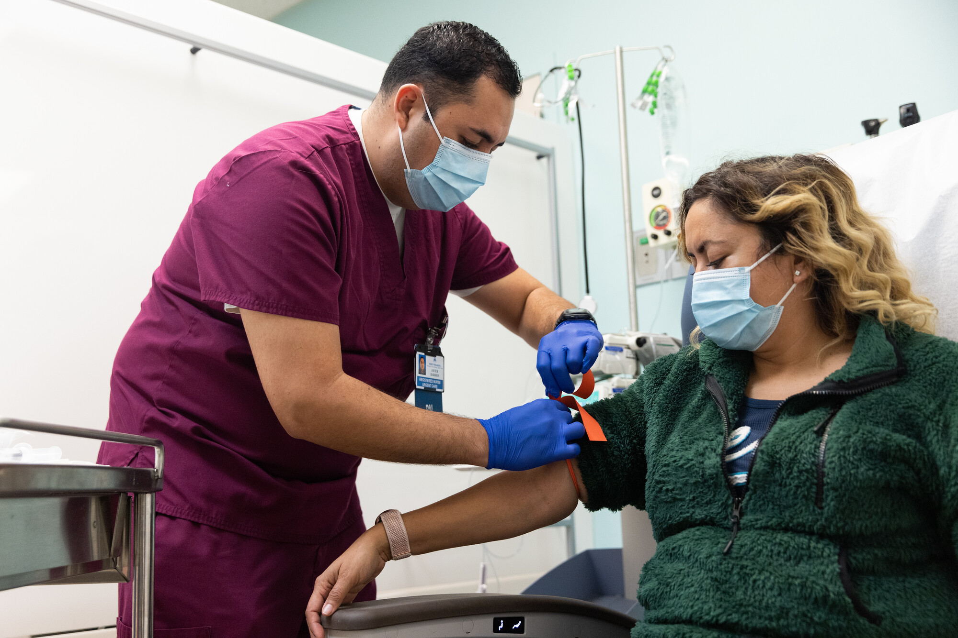
How might we improve outpatient flow?
Ensure clinic day starts on time
Decrease failure to keep appointments
Stagger start times for medical assistants to ensure physician support

Slide 18
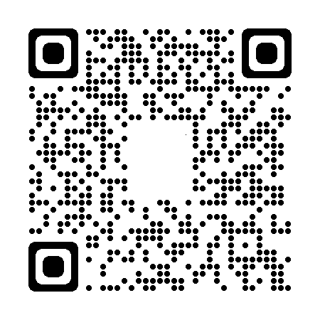

Multiply the Wins: Spread and Adopt
Scan the QR code for tips on spreading and adopting successful practices
Notes:
And what if UBTs that succeeded in saving money and increasing efficiency shared their experiences with other teams? What if UBTs adopted successful practices from one another? Then we could multiply the savings across facilities and markets.
Scan this QR code for tips and tools about how to spread and adopt successful practices. It requires a shift from “not invented here” to “proudly found elsewhere.”
https://www.lmpartnership.org/stories/steal-shamelessly

Slide 19

WE CAN DO IT!
Notes:
We have the tools. We have the people. We can do this!

