Slide 1
Presentation Guidelines
LMP Communications
2022
Notes:
Have a presentation you need to give for your latest LMP UBT project?
Want to tell your team about a new way of working?
Check out the latest PowerPoint presentation guide from our LMP communications team.
2022

Slide 2


Design: Use an LMP Template
Choose the right PowerPoint template – visit LMPartnership.org > tools or Search: template
Notes:
Visit LMPartnership.org to download the right template for your presentation
There are several to choose from – standard LMP one, the Basics, Joy in Work, or a UBT health and safety champions
https://www.lmpartnership.org/tools/lmp-PowerPoint-templates
UBT champion template: https://www.lmpartnership.org/tools/ubt-champions-powerpoint-template

Slide 3
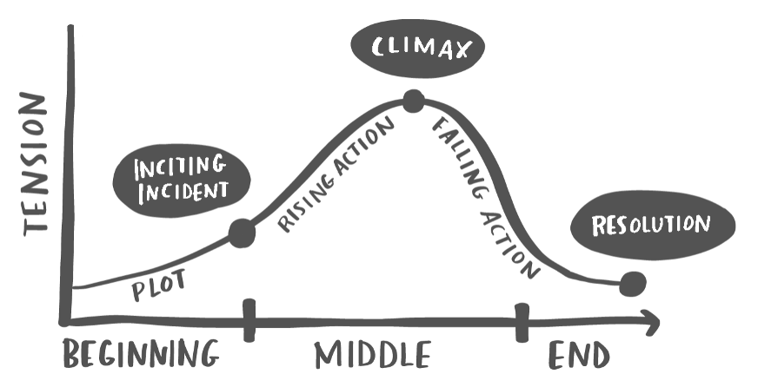
Structure: Tell a Story
Frame your presentation with a narrative arc
  Lead with a story, finish with data
  Problem, Solution, Result
  Situation, Background, Assessment, Recommendation
  Plan, Do, Study, Act
  Always end with a Call to Action
Notes:
Frame your presentation with a narrative arc
Stories help the audience remember your point. Use stories and data together to drive action.
Use stories AND data to make your point
Problem, Solution, Result
Plan, Do, Study, Act
Situation, Background, Assessment, Recommendation
End with a Call to Action – what do you want the audience to do? Create an Affordability project? Increase mail order pharmacy delivery?

Slide 4
Content: Use Your Talking Points
Use bullets to highlight and reinforce your talking points
Put content in the Notes section
Consider handouts or links for detailed information
Know your audience – speak to their needs
Play short videos to keep engagement
Pro Tip:
  Don’t read your slides – talk about the content
  If the presentation is for others to use, include enough information in the notes or appendix for their success
Notes:
Don’t ask your slides to do all the work—put most content in the Notes section
Use slides to provide hooks for understanding—not to duplicate your spoken remarks
If you need to include more detail, consider using a handout
Know your audience—who they are, why they’re there, what you want them to do and how they’ll use the information
If the deck will be used for later discussion (rather than presented by a speaker), include enough content in the slides, notes or appendix so they can succeed in their presentation

Slide 5

Length: Keep it Short and Simple
Avoid complex language, jargons, and acronyms
Be concise with your points
Keep your tone conversational and light if appropriate
Aim for no more than 10 slides,
delivered in 20 minutes or less
Pro Tip:
  Practice, practice, practice
Notes:
KISS
Avoid complex language, jargons, and acronyms
Be concise with your points. Tell your story in a simple sentences
Keep your tone conversational, don’t lecture, engage. Be light if appropriate.
Aim for no more than 10 slides, delivered in 20 minutes or less – stretch if you need to.
Allow time for questions
Engage your audience, if possible, with polls or breakout rooms
Practice your presentation, the more comfortable you are with the material/content, the more confident and flexible you will be if you have technical difficulties, or if questions arise

Slide 6
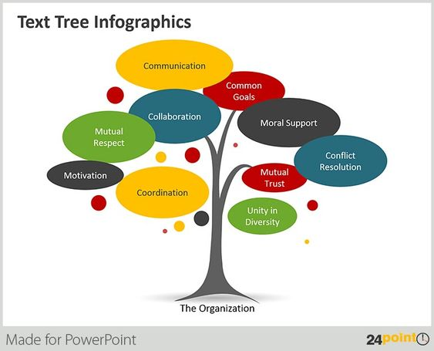
Style: Text and Graphics
Less is More
Give space to images or graphics
Use images to connect to your story
Avoid small fonts (use at least 16 points)
Use bold type instead of italics
Notes:
Avoid crowing text. Break it up. Use bullets or short sentences.
Know your main points and add context when you need to
Less truly is more!
Give more space to images and graphic than to text
Use images to connect, support, set a tone, or tell your story
Show short videos that compliment your information and to keep viewers engaged
Avoid small fonts (use at least 16 points) match the destination formatting of your template
Don’t mix font types
Bold your type - italics are harder to read

Slide 7

Final Thoughts
Don’t forget to add a survey or poll to your presentation
Allow time for questions and answers
Add a Resource slide to your deck
Provide pdf handouts or digital links
Include your contact info
Thank your audience
Notes:
Don’t forget to add a survey or poll to your presentation – in Teams you can use Forms – or polling in Zoom
Allow time for questions and answers – make sure you were understood
Add a Resource slide to your deck – if you have a large report that you want others to read, add a link on the resource page or share in “chat”
Provide pdf handouts or digital links for further reading – drop those in the chat if virtual
Include your contact info – let the audience know you will follow up if you don’t have the answer or information at that time
Thank them for their attention and time – be gracious

Slide 8
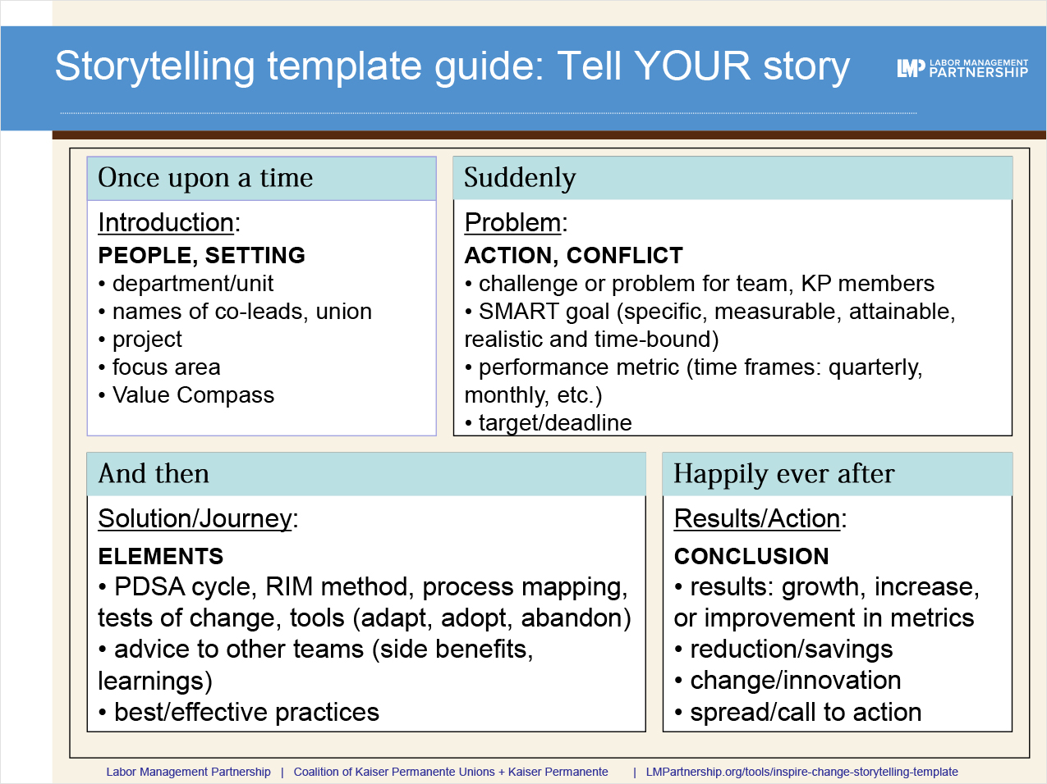

Resources
LMPartnership.org
  PPT templates
  Storytelling
  LMP brand guidelines
Notes:
Resources
LMPartnership.org is a great site to start under Tools
Download LMP or champ PowerPoint templates. https://www.lmpartnership.org/tools/lmp-powerpoint-templates
UBT champion template: https://www.lmpartnership.org/tools/ubt-champions-powerpoint-template
Search keyword: templates; storytelling. https://www.lmpartnership.org/tools/inspire-change-storytelling-template
LMP brand guideline: https://www.lmpartnership.org/sites/default/files/lmp_brandguidelines_2021_v2.pdf
Search KP Learn for courses to gain more skills.
Be humble, kind, and confident. You’ll do just fine.

